Slide 1
Start by Following Directions to Chris and Arianna’s Stat Project

Slide 2
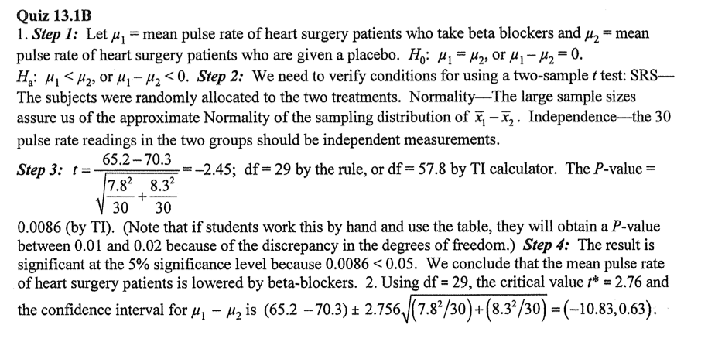

Review the “Quiz” HW with a partner – Answers Here.

Slide 3
Posters/Assignment 2
Assignment 2 is due Monday – Data emailed and a Title, Brief Method, and 2 Figures are included.
1.) First email your data to Mr. Young.
2.) Poster: Create a title, write a method, and include 2 visuals on your PowerPoint.
3.) See my website for a sample poster (or the hard copy between Amanda’s and my room).
4.) I have put up a template on my website – use this to add your content to your poster.

Slide 4
2 Sample Proportions
Do males or females wear their seatbelt more?
Does taking aspirin reduce heart attacks (placebo vs. treatment)?
Does the faculty enjoy the lunches more than students this year at MB?

Slide 5
Conditions

Slide 6
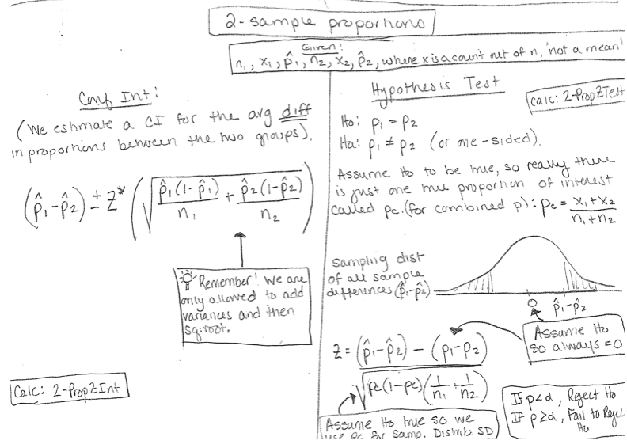

Slide 8
HW/Classwork
13.42, 13.43, 13.44, 13.45
Comp Lab Tomorrow/Review Monday/Test Tuesday

