Slide 1
HONORS PRECALC: Warm-Up
1.) Fill out the first quadrant of the unit circle (see if you can do it without looking). Check your work with the actual unit circle.

Slide 2
Reminders
A little note: a lot of section 5.2 we have essentially already covered in Ch. 6 .
Quiz tomorrow on unit circle.

Slide 3
Definitions of Trig Functions
Recall that t is simply the distance around the unit circle (it is measured in radians)
Un-shifted trig functions

Slide 4
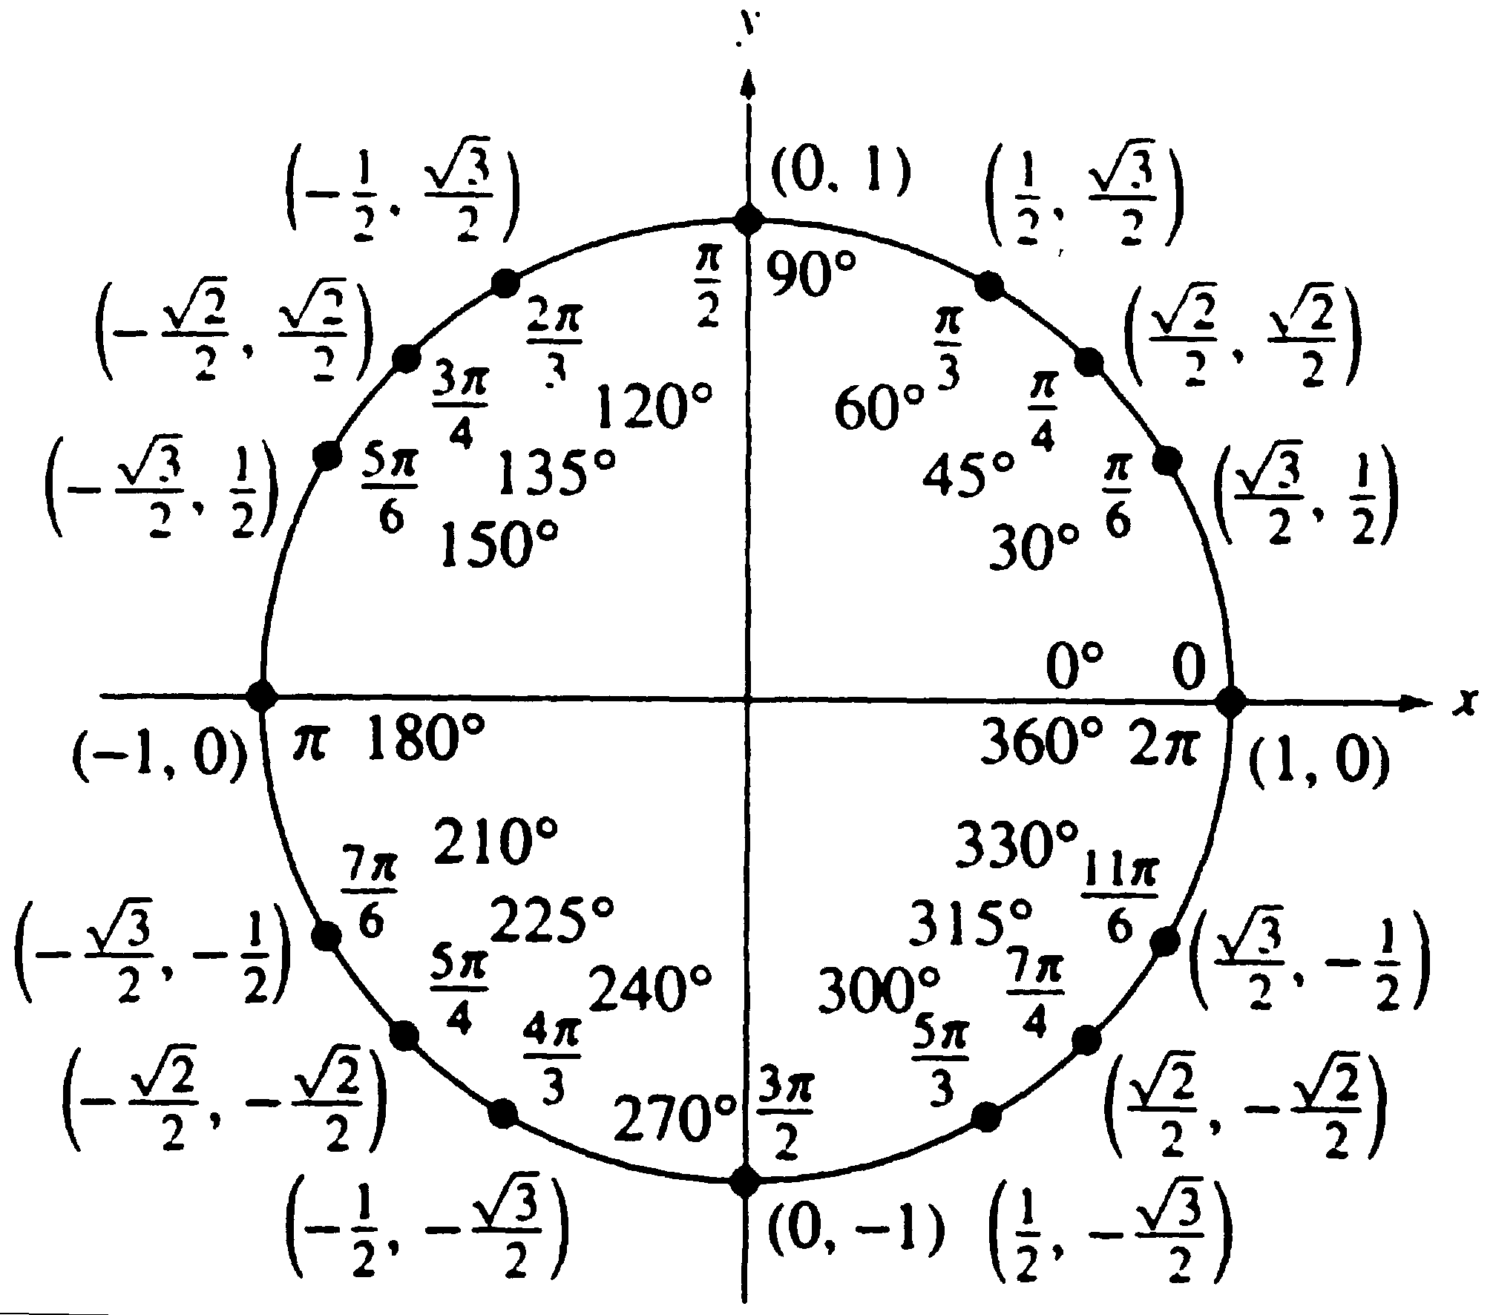
Evaluating Trig Functions

Slide 5
Evaluating Trig Functions

Slide 6
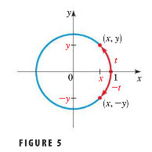
Even/Odd
Even functions are symmetric over the y-axis
Odd functions are symmetric about the origin

Slide 8
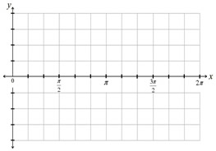
Graphing the Sine Function
The sin and cosine functions have a period of 2π

Slide 9
Graphing the Cosine Function

Slide 10
Homework #12
Be ready for a 5 minute unit circle quiz.
Section 5.2 Page 416: #4, 5, 6, 13, 19, 27, 29

