Slide 1
AP STATS: DO NOW
We will be doing an abridged version of 4.1 in the textbook and cruising through Chapter 4. I would highly suggest reading 4.1 to make sure that you understand the general idea. I will also post a handout from an AP prep book that covers the idea in a more succinct way.
TAKE ABOUT 5 MINUTES TO READ AND DISCUSS YOUR CLASSMATE’S PROJECT.
DISCUSS THE FOLLOWING: What are some strengths of the paper? What information would have helped you understand the paper better?

Slide 2
Writing your Method:
Assume the reader does not know…. Be specific.
“Researchers collected data from sample of 27 participants who were asked their age, gender, and how many hours they spend reading per week on average. Participants indicated the answers to these three questions on a survey. Participants were randomly selected to participate in the survey from the researcher’s classes at Moses Brown School, an elite, private high school in Providence, Rhode Island. Subjects ranged in age from 14 to 45 years old and approximately half of the subjects were male and half were female (47% male and 53% female).”

Slide 3
Define Important Terms
What is “pole position”? What is “Driving Accuracy” or “Greens in Regulation”? What does it mean to read for “fun” (i.e. what constitutes it)?

Slide 4
Transformations to Achieve Linearity.
Often a linear model is NOT the best model for depicting a relationship between two variables.
Two clear ways to identify this:
1.) The scatterplot shows a distinctive curved pattern
2.) The residuals show a distinctive pattern rather than a random scattering.
Sometimes the nonlinear model can be revealed by transforming one or both of the variables and noting the linear relationship. These transformations can often be done by taking the log (or natural log) of one or both of the variables.

Slide 5
What’s a log again?
5² = 25
4^{x} = 64
Log 100 = 2
Some helpful reminders:
10ª10^{b = ???}
10^{log x} = x

Slide 6
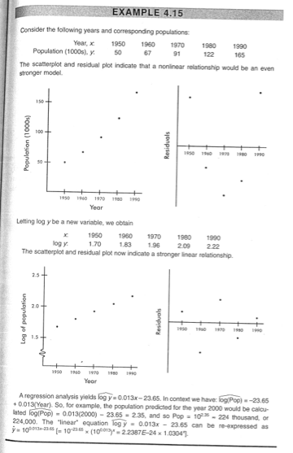

Slide 7
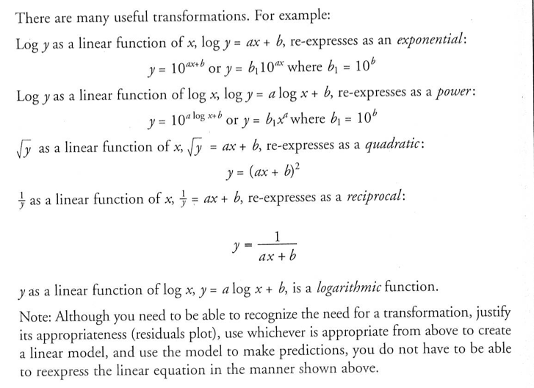
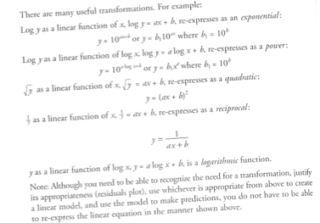

Slide 8
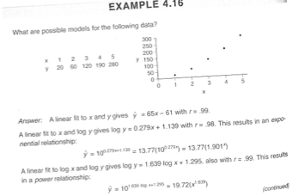
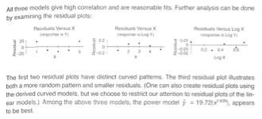

Slide 9
Take your Multiple Choice Questions from Last Week Out.
Work in your groups.
#6, 29,

Slide 10
HW #27
Complete Multiple Choice Questions #

