Slide 1
AP STATS: Do Now-4.19 Textbook

Slide 2
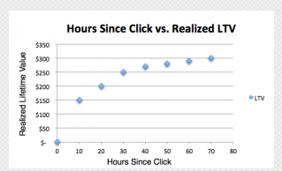
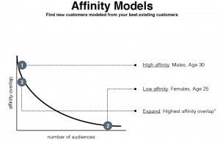
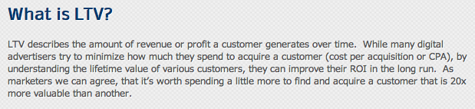
Idea of the Day
Stats from Nanigans, a Facebook advertising company.

Slide 3
Quick Reminder
The base for the natural log (ln) is e.
e is approximately 2.71828

Slide 4
Multiple Choice Question

Slide 5
Next Test and Quiz on 4.2
Our next test will be cumulative and cover questions from Chapters 1-4. It will focus on Chapter 4 for a decent part of the test however (but not by much…)
We will be doing some review of previous content as we go about… You will also get a nice multiple choice review set.
Group Quiz/Take Home Quiz on 4.1/4.2 Thursday. Open Notes/Textbook. Be sure to read section 4.2 tonight. You will be assigned a partner for 15-20 minutes of class and than it will be take home to complete.

Slide 6
AP Stat: Exam Tip…
No CALCULATORSPEAK
Readers of your exam don’t want to see something like… “I did lin reg ax + b L1, L2, Y1”. They will assume that this is what you did. Simply report the result!!

Slide 7
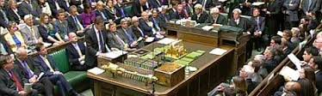
QUESTION TIME

Slide 8
Question Time
You are told that the correlation between two variables x and y is 0.85. What can you infer from this information?

Slide 9
Question Time!!!
What’s the difference between a statistic and a parameter?

Slide 10
Question Time!

Slide 11
Question Time!
Is it possible for the standard deviation of a set of data to be negative? Zero? Explain.

Slide 12
Question Time!
True or False. The area under the normal curve between z=0.1 and z=0.5 is the same as the area between z=0.3 and z=0.7.

Slide 13
A Quick Lesson on 4.2
Relationships Between Categorical Variables
Two Way Table:
Row Variable:
Column Variable:
Calculate Totals if Missing
Marginal Distribution: data in the margins (row and column totals)
Conditional Distribution: When we compare percent of women in two age groups for example
You could make bar charts, circle graphs etc. of the percents

Slide 14
Simpson’s Paradox
Lurking variables can be present for categorical variables too!!!
An association or comparison that holds for all of several groups can reverse direction when the data are combined to form a single group. This Reversal is called Simpson’s paradox.

Slide 15
BUT…..

Slide 16
Important Note:
Keep in mind that we are talking about categorical variables here and we are looking at counts and percents. So we can’t determine a correlation for example between the variables.

Slide 17
HW 28:
Read all of section 4.2. We will have an open notes quiz tomorrow.
Complete exercises 4.23, 4.36, 4.39

