Slide 1
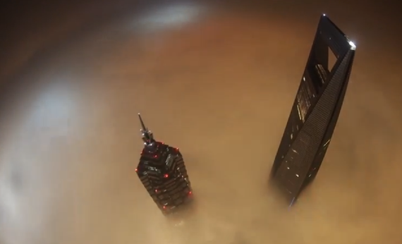
Honors Precalculus: Do Now
1.) You are standing at a distance from the tallest skyrise in China (The Shanghai Tower). Rather than count the number of steps to the base of the building, you take the angle of elevation (from the ground) from where you are standing and find it to be 74°. You then walk 1000 feet further away from the building and take the angle of elevation (from the ground) and find it to be 52°. Determine the height of the building (ignore the angle of depression)
Quiz on 6.1-6.3 will be on Friday. HW checked that day (please have it ORGANIZED and in order.

Slide 2
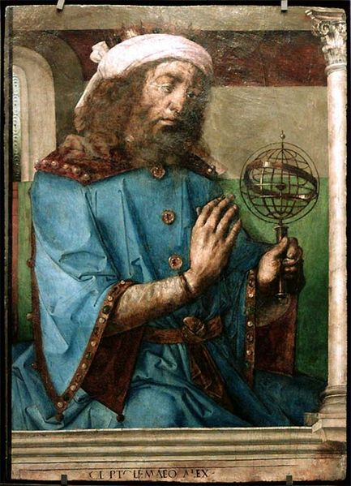
Quote of the Day
“Today I will do what others won't, so tomorrow I can accomplish what others can't”
― Jerry Rice
Yesterday we will measure the height of Hope High so today we can measure the height of anything!
Congrats to our new students of the Quarter:
Claudia Marzec
Alden Taylor
David Eides

Slide 3
Trig Functions of Angles: Unit Circle
Trig functions of angles will allow us to solve problems that involve angles which are
not necessarily acute. (ASTC – QUADRANTS)
y
x
Note: why is it called sine, cosine, tangent, cosecant, secant, and cotangent.

Slide 4
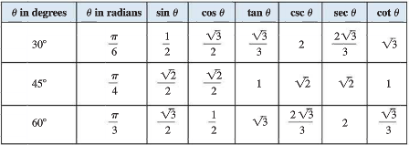
Example 1: Find
a.) cos 135° and b.) tan 390°

Slide 5
Reference Angle
The acute angle formed by the terminal side of θ and the x-axis. Signified with theta-bar.

Slide 6
Example 2:
Find the reference angle for the following.

Slide 7
Steps for determining the values of trig functions for any angle θ
1.) find the reference angle of θ
2.) determine the sign of the trig function of θ by noting the quadrant (ASTC)
3.) The value of the trig function of θ is the same, except possibly the sign, as the value of the reference angle.

Slide 8
Example 3: Using Reference Angles
Find sin 240° and cot 495°

Slide 9
Example 4: Using Reference Angles
Find

Slide 10
Whiteboards: HW Reductions

Slide 11
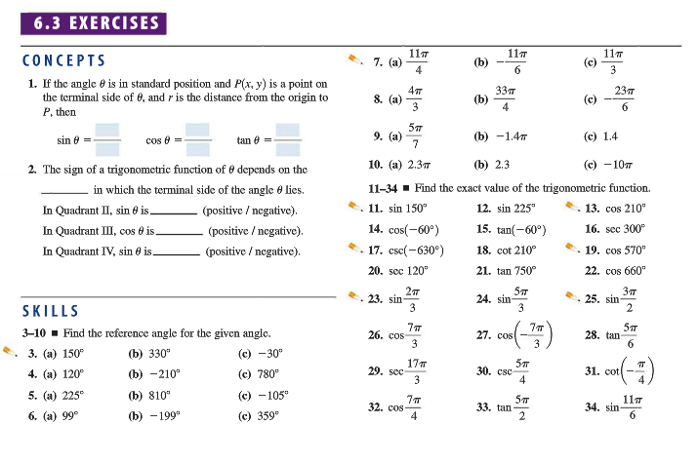
HW #12
Section 6.3 (page 459-460)
#3, 5, 7, 11, 13, 17, 23, 27, 35

