Slide 1
Honors Precalculus: Do Now
Verify the Identity
1.)
2.)

Slide 2
Quote of the Day
“Genius is 1% inspiration and 99% perspiration.”
Thomas Edison

Slide 3
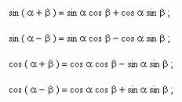
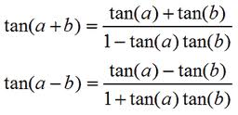
Addition and Subtraction Formulas

Slide 4
Example 1: Using the Addition/Subtraction Formulas
Find the exact value of each.
a.) cos (75°) b.) cos (π/12)

Slide 5
Example 2: Using the Addition formula for sine
Find the exact value of sin (20°)cos (40°) + cos (20°)sin (40°)

Slide 6
Example 3: Proving a Cofunction Identity
Prove that

Slide 7
Example 4: A example from calculus
If f(x) = sin x show that the derivative formula =

Slide 9
Sum of Sine and Cosine
If A and B are real numbers, then:
Asin x + Bcos x = k sin (x + Φ)
Where K =

Slide 10
Example 5: Sum of Sine and Cosine
Asin x + Bcos x = k sin (x + Φ)
Where K =
Example: Express 3sinx + 4cos x in the form k sin (x + Φ)

Slide 11
Example 6: Graphing a Trig Function
Asin x + Bcos x = k sin (x + Φ)
Write the function f(x) = -sin (2x) +√3 cos (2x) in the form
K sin (2x + Φ):

Slide 12
HOMEWORK #22
Section 7.2 #3, 7, 9, 13, 15, 23, 25, 55

