Slide 1
Honors Precalc: Do Now
Complete the following problem by making a sine regression on your calculator.

Slide 2
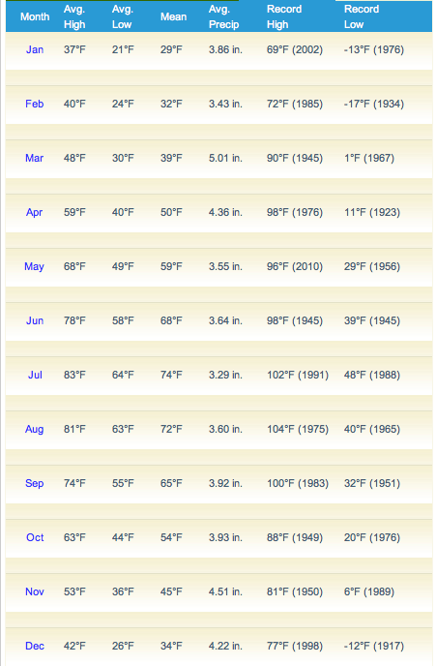
Providence Temp

Slide 3
Analytic Trig
Solving/simplifying problems with trig. (i.e. the algebraic properties)

Slide 4
Fundamental Identities

Slide 7
You Try! Simplify These
(1 + sin y)(sec y – tan y)
$$\frac{\sin{θ+\cot{θ\cos{θ}}}}{\cot{θ}}$$

Slide 8
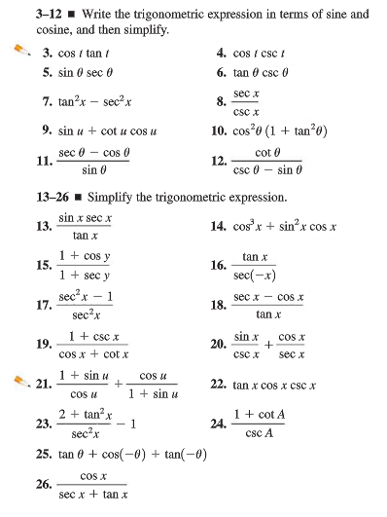
HW #20
Re-read Section 7.1 (Example 1 and 2)
Section 7.1 (pg. 498) #3, 5, 7, 13-24

