Slide 1
AP Stats: 2 Minutes
Group 1: How to study more efficiently.
Design a study to help determine how individuals can study more effectively. Create experimental groups to test your findings. Explain your experimental design.
Group 2: What makes plants grow faster and bigger?
Design a study to help determine what factors matter for plant growth. Explain your experimental design.
Thinking twice about your study? Feel free to use on of these. The plant ones are a lot of fun. Like a MS science experiment but with stats to back up your results.

Slide 2
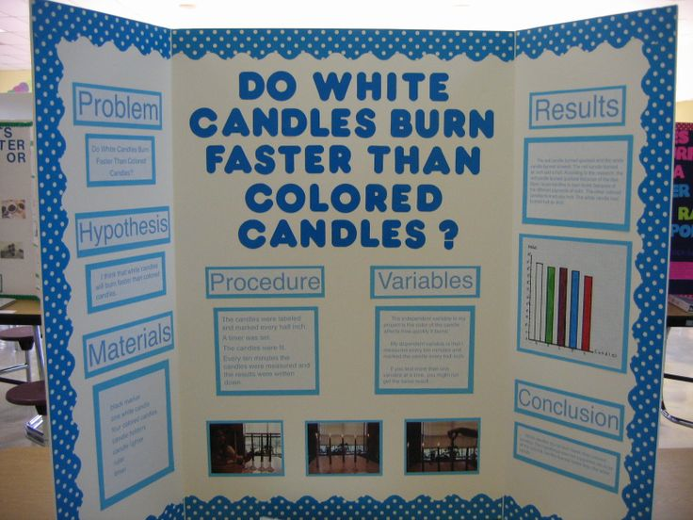
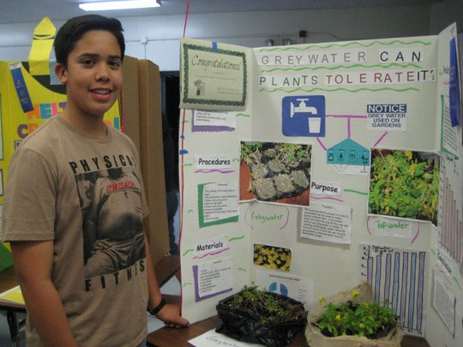
Taking MS science fair projects to the HS/ College level
Beyond bar graphs… Inference!!!

Slide 3
AP EXAM COMING UP SOON!!
3 chapters left!! Then Review
2 Sample T-Tests, 2 Sample Prop Tests, Chi Square, Inference for Regressions.
Projects will be presented on May 2nd (during 5th period and again during the extend).
Assignment 2 due on Monday, April 7th – data collected
April 14th Stat trip to Brown to view the MPH students poster presentations.
AP Exam is May 9th! Stay Motivated (let’s get 4’s and 5’s!!).
Research AWARDS
1st Best Poster (best overall)
2nd Runner up
3rd Best communicator
4th Most novel idea
5th Best study design

Slide 4
Test Notes
#9.) plot the data (histogram or boxplot) if n is small or medium and are not told that it is normally distributed. Actually sketch a graph too!
Read, read, read – there was a problem just like #9 in the textbook.
Low p-values are GOOD (help to reject the null hypothesis).
#10a. The population is ALL MnM’s. and the parameter is the percent that are yellow.
#10b Normality – npo > 10 and n(1-po)>10 not the CLT. That’s for means not proportions.
I gave you #4 as your curve.
Show your setup on hypothesis tests, confidence intervals, etc. You may use your calc to get the results but this is how you can show work.

Slide 5
2 Sample Problems
Which drug, Lipitor or Pravachol, helps lower bad cholesterol more?
Which incentive program for a credit card encourages more spending?
Are males or females more likely to binger drink in college?

Slide 7
Conditions

Slide 8
2 SAMPLE T-TEST/2 sample t-interval
ON CALC: NEVER POOL!!!!

Slide 10
Robustness
Two sample t procedures are more robust than one sample t methods particularly when the distributions are not symmetric.
The two samples need to be the same size, and have similar shapes. (Accurate for as small as
n1 = n2 = 5 for example).
CHOOSE EQUAL SAMPLE SIZES IN GROUPS. THIS IS WHEN THE TEST IS MOST ROBUST!!

Slide 11
HW #17
Read section 13.1 (except for the formula about how to calculate degrees of freedom by hand).
Complete quiz 13.1b

