Slide 1
AP STATS:
WLECOME BACK FROM BREAK!!!
Grab your HW journal which has your unit test in it. Look it over independently. We will be going over some of the free response questions today in class.
The average was a 77 (with a 9 point curve) with a standard deviation of 16.5!!
Multiple Choice questions (60% of the grade) were worth 4.3 points each and I added 2 extra questions to your score which constituted the curve.
Corrections to ALL of your Free Response Questions can get you an additional
3 points on your test tomorrow. Your answers must show ALL your work though.

Slide 2
Agenda:
We will be completing Chapter 8 this week.
We will have a test on Monday, January 13th on Chapter 8.
Tuesday Jan 14th is a drop.
Wednesday, Thursday and Friday will be review days.

Slide 3
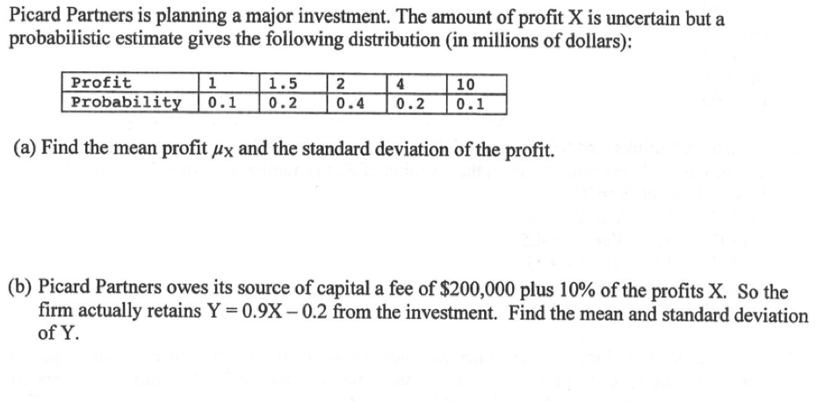

Slide 7
Happy Holidays: It’s POP QUIZ TIME
Label your paper 1-10. This quiz will be all multiple choice (a-e just like an AP test).

Slide 8
Happy Holidays: It’s POP QUIZ TIME
Label your paper 1-10. This quiz will be all multiple choice (a-e just like an AP test).
1.) D
2.) D
3.) D
4.) C
5.) B
6.) D
7.) A
8.) D
9.) C
10.) D

Slide 9
Here’s some questions you’ll be able to answer at the end of this chapter
Mr. Young shoots 65% from the free throw line.
He’s going to shoot 75 free throws this afternoon. What is the probability that he makes exactly 50? More than 50? No more than 40? Between 45 and 55 free throws?
Or… What’s the probability that a baseball player who bats
.260 will bat .300 in a given season. (about 2.5% by the way).

Slide 10
8.1 The Binomial Distribution
Definition: “The Binomial Setting” :
A situation is said to be a “BINOMIAL SETTING”, if the following four conditions are met:
Each observation is one of TWO possibilities - either a success or failure.
There is a FIXED number (n) of observations.
All observations are INDEPENDENT.
The probability of success (p), is the SAME for each observation.
NOTE: Sampling Distribution of a Count
** When the population is much larger than the sample, the count X of successes in the sample has approximately the binomial distribution with parameters n and p.

Slide 11
8.1 The Binomial Distribution
Definition: “Binomial Distribution”
The distribution of the count X of successes in the binomial setting is the BINOMIAL DISTRIBUTION with parameters n and p.
n = the number of observations
p = the probability of success on any one observation
A way to symbolically say this: B(n, p)

Slide 12
Look over example 8.1-8.4 with your group – these are from your book.
Next to each example write if the scenario satisfies the 4 conditions for a
BINOMIAL SETTING. Also, write which condition is NOT met it is not a BINOMIAL
SETTING.

Slide 13
Calculating the Probability by Hand without a Formula
Each child born to a particular set of parents has probability 0.25 of having Blood Type O. If these parents have 5 children, what is the probability that exactly 2 of them have Type O blood.

Slide 14
HW 40
Read Chapter 8 through example 8.6 (prereading for tomorrow’s class).
Complete exercises 8.1-8.5
Complete your make-up problems.

