Slide 1
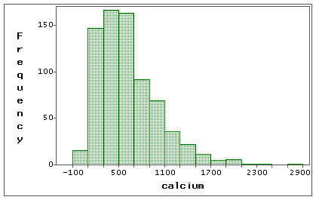
AP STATS: Quick Review
Below is the histogram of the amount of calcium levels in a sample of patients.
1.) Draw an appropriate density curve.
2.) If the mean is 800 and the standard deviation is 300, then what z-score (standardized score)
would a calcium level of 1200 be?
3.) What would you expect the median to be approximately?

Slide 2
QUIZ!
Question 2: For percentile use the following definition: The percent of people that fall at or below that value.

Slide 3
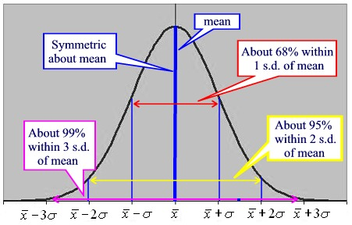
Finding the Standard Deviation Visually

Slide 4
What happens when you change the standard deviation of a normal distribution?

Slide 5
Why use normal distributions?
1.) Sometimes represent REAL DATA (like height, SAT, etc.).
2.) Normal distributions are good approximations for many chance outcomes (like flipping a quarter).
3.) Many statistical inference procedures based on normal distributions work well for approximately symmetric distributions.

Slide 6
Normal Distribution Notation
N(μ,σ).
The distribution of young women’s heights (aged 18-24) is approximately Normal with mean μ=64.5 inches and standard deviation σ=2.5 inches.
Draw a normal distribution showing this distribution (make sure to go plus/minus 3 standard deviations from the mean).

Slide 9
Using Table A
Find the proportion of observations from the standard Normal distribution that are less than z=2.22

Slide 10
Normal Distribution Calculations

Slide 11
HW #16
2.24, 2.25, 2.26, 2.29
Also, work on your project due Friday. No HW tomorrow other than the project.

