Slide 1
AP STATS:
25 Point Group Quiz – Sit in the groups below – they were randomly generated by a computer.
You may use your notes, textbook, calculator and formula sheet.
Work together to complete the quiz. You only need to hand in one copy per group (make sure all names are on the top).

Slide 2
Review Game: For a HW Pass
In your same teams. Questions will be worth the same amount of points for each
Question (100 points). There will be occasional bonus rounds with a random trivia
question.

Slide 4
Answer
About 13

Slide 6
Answer
89.8% would fall below (normal distr)
89.8% (actual observations)
The normal distribution describes the data well.

Slide 7
Who won the nobel prize in Physics this year (name one of the two)

Slide 8
Answer
Peter Higgs
Francois Englert

Slide 10
Answer:
The mean is 250.
Standard Deviation is 175.8

Slide 12
Answer
C

Slide 14
What is the cash prize (in USD) for the Nobel Prize in 2013?
Closest answer wins

Slide 15
Answer
$1,229,256

Slide 16
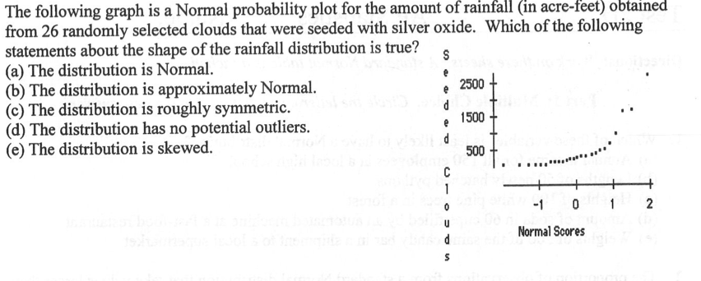

Slide 17
What invention caused Alfred Nobel to become so wealthy?

Slide 18
Answer
dynamite

