Slide 1
AP STATS
Test Tomorrow. We will Review for about 10-15 minutes today. Because the test is 1st period make sure to come right at 8:10AM tomorrow to start your test.
We will then go into Lubrano to work with Minitab (you might have to share a computer).
This will help you with your project.

Slide 2
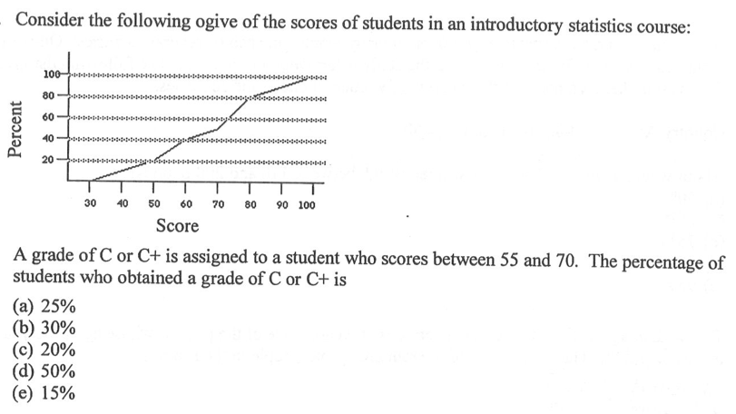
Review Problem 1

Slide 3
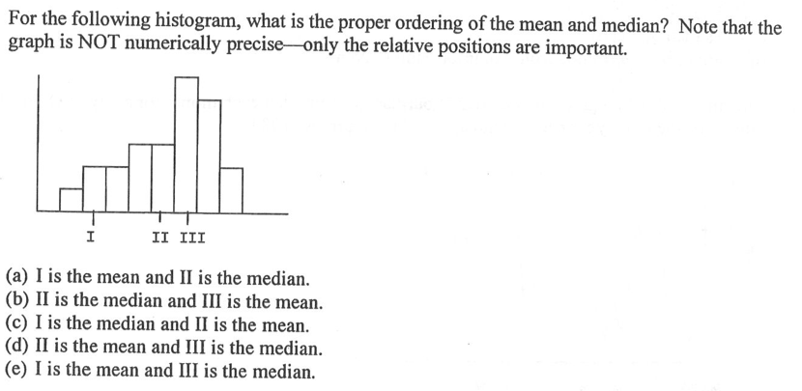
Review Problem 2

Slide 4
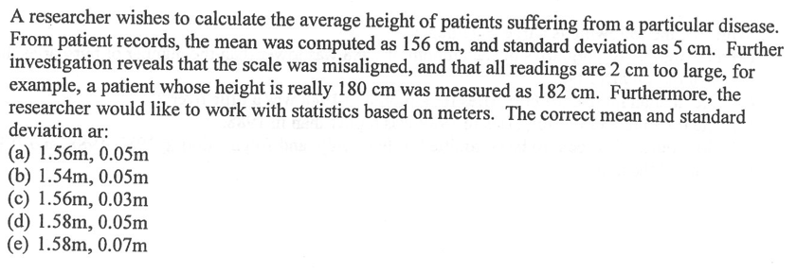
Review Problem 3

Slide 5
Project Details
The project will be due next Friday. You will need Minitab to complete the graphs
PART 1: Find or Produce Data
PART 2: Analyze your Data
PART 3: WRITING AND INTERPRETING YOUR FINDINGS
Introduction: (1 paragraph) Explain what question you are examining and why you are interested in that particular question. Provide any relevant background information that you think could be relevant to a reader and things that could “hook” the reader into why your question is relevant. Also include your hypothesis. What did you expect to find before conducting the study?
Method: Explain briefly how (or from where) you collected your data.
NOTE: Your intro and method should address the Who? What? Why? Where? When? How? By Whom?
Results: Display graphs of your findings and any numerical summaries that you conducted. Be sure to label graphs. You don’t need to interpret your results in this section as you will do so in your conclusion.
Conclusion: Write an analysis of your findings. What can you say about the data that you collected? What stood out to you? Were there any problems in the way that you collected the data? What are the implications of your findings?

Slide 6
Lubrano Minitab
AP Statistics Minitab Chapter 1 Activity
Paste all answers below the number for the question being asked.
Set Up
Log on to the computer (use windows) and open Minitab (desktop or start—all programs).
When it asks you for license data edit the 27000 so that it reads 27000@mb-license. Hit enter.
Go to my website and download the class survey data under HW #4 (the excel file). Copy everything from the file into minitab.
Bar Graphs
Graph 1: Make a bar graph of Wash Hands using counts of people on the Y-axis. Can you figure out how to add a title to your graph? Copy and paste this into word.
Graph 2: Make a bar graph of Wash Hands using percent of people on the Y-axis. Include a title and copy into word.
Pie Charts
Graph 3: Make a pie chart of gender. Add a title and copy into word.

Slide 7
Video

