Slide 1



AP STATS: Warm UP
In the Pass the Pigs game yesterday there were 15 “Pig Outs” out of 73 total
rolls according to your data.
a.) Construct a 95% confidence interval for the probability of a Pig Outs on any given roll?
b.) Mr. Young thought that the true probability was p=0.30. Perform a significance test at the 5% level to determine whether there is evidence to suggest that the true probability is actually less than 30%. Just do the calculations and interpretation.
Test Tomorrow: HW #14-16 will be checked tomorrow

Slide 2

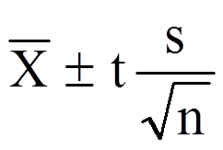
Z-Tests, T-Tests and 1-Prop Z Tests
T-Tests: for means
1 Prop Z Tests: for Proportions
T Interval: Confidence Interval for Means
1-Prop Z-INT: Confidence Interval for Props

Slide 3
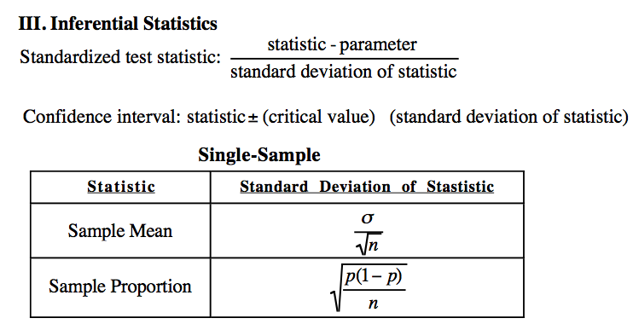

Slide 4
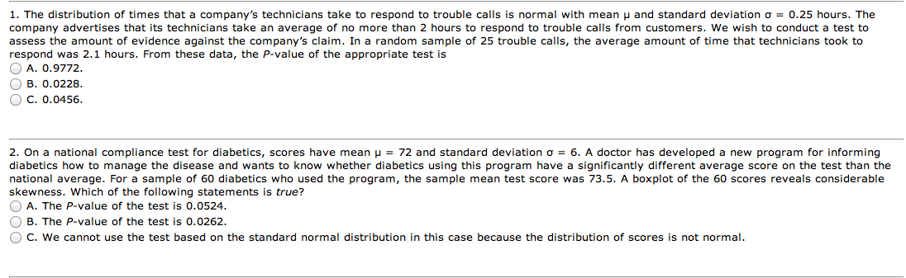
Review Game

Slide 5
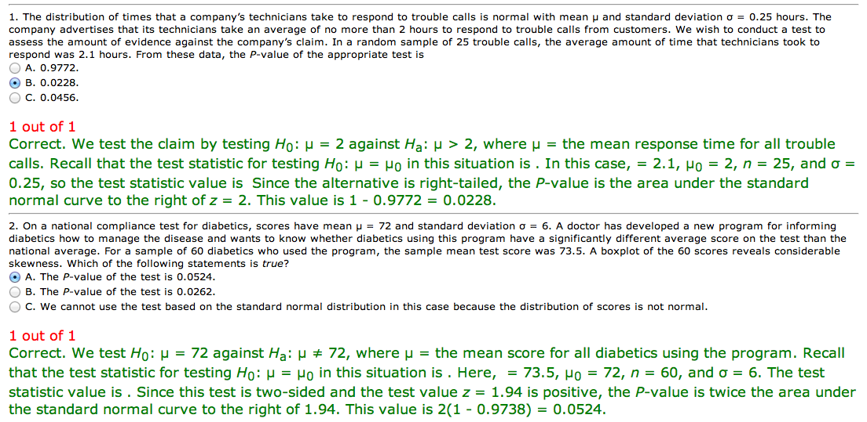

Slide 6
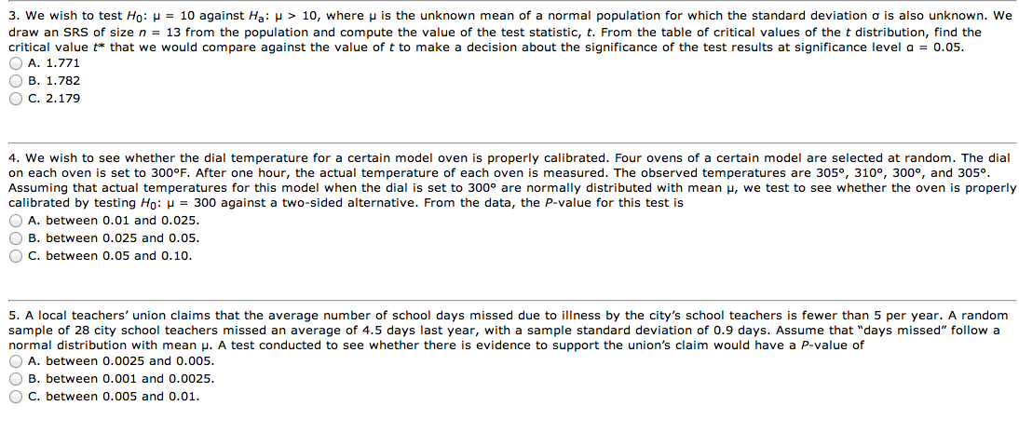
Hint: Use Table C – t-distribution for #3 (we have just been using our calculator)

Slide 7
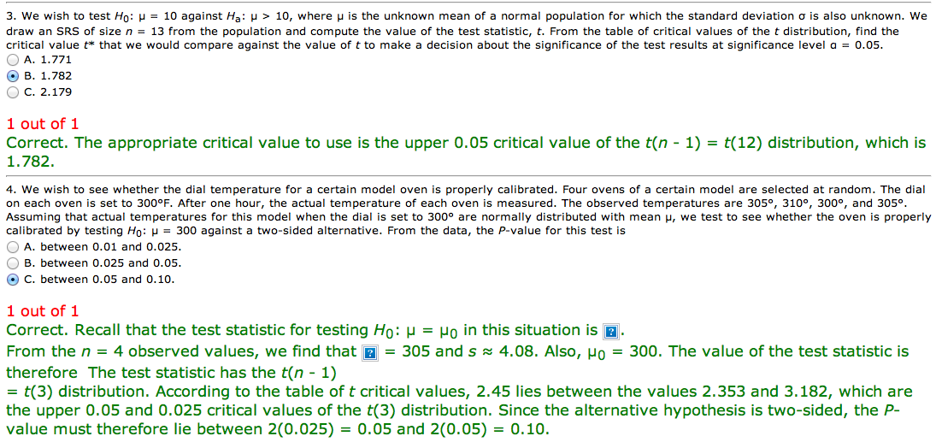
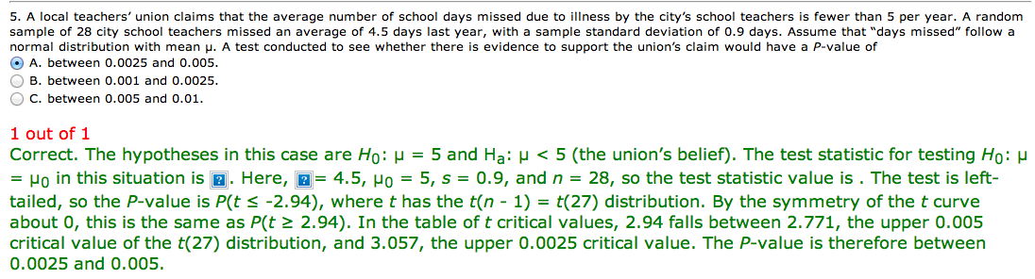

Slide 9
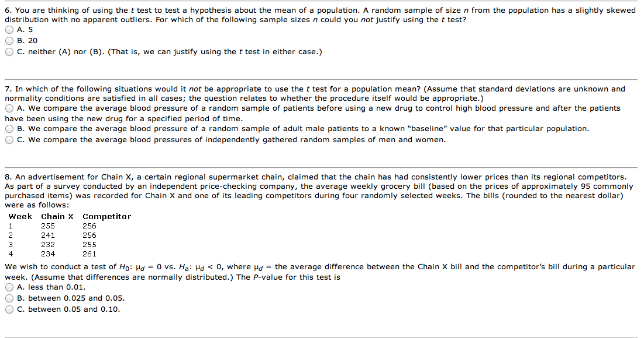

Slide 10
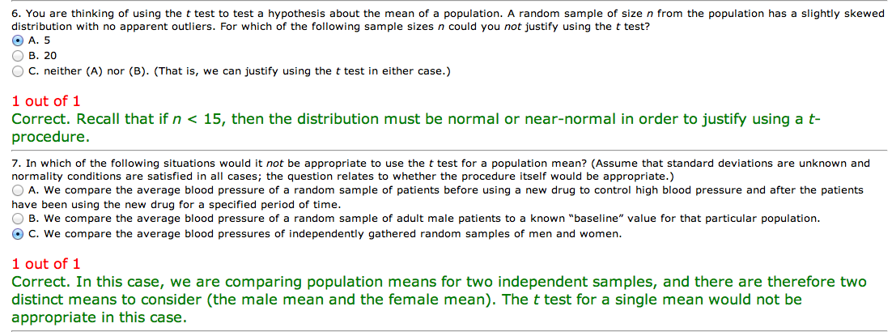
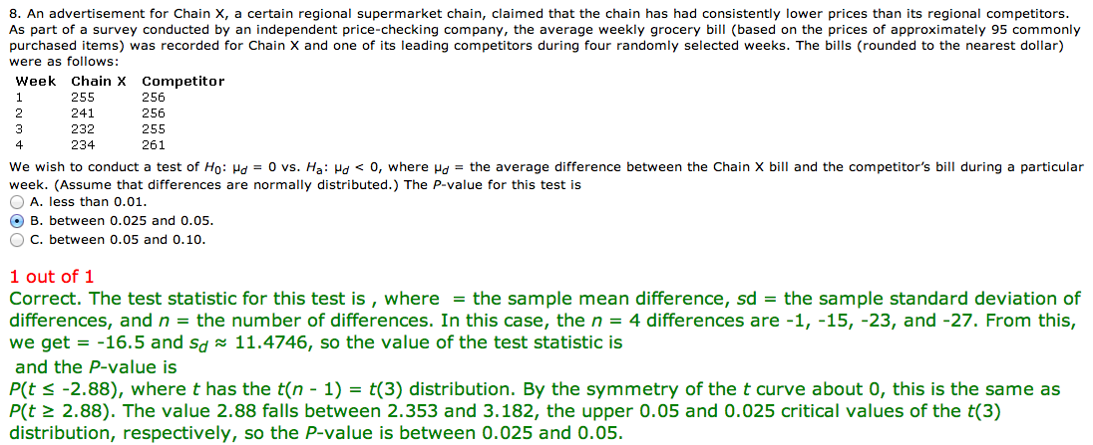

Slide 11
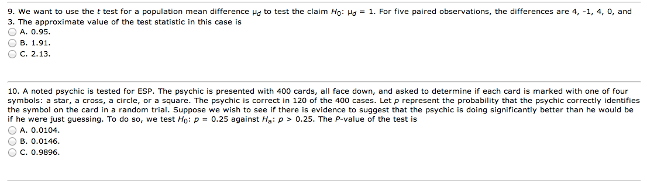

Slide 12
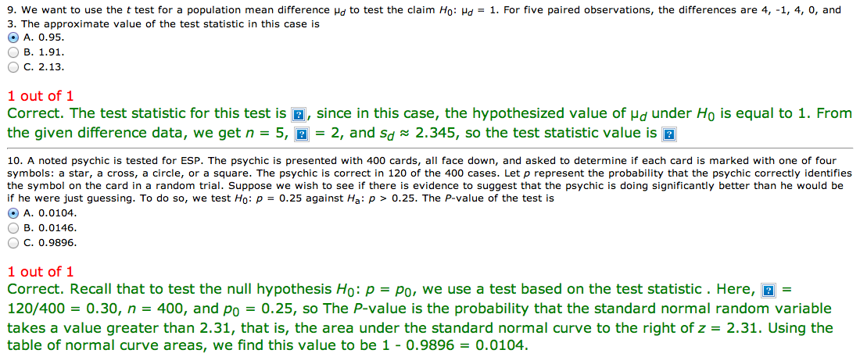

Slide 13
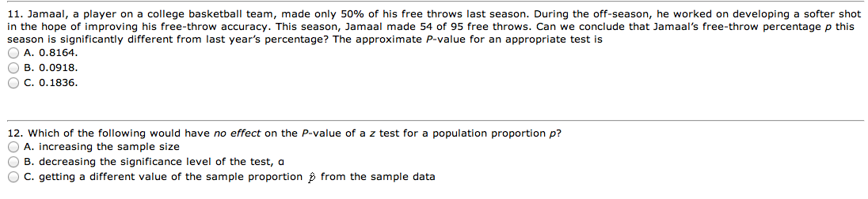

Slide 14
