Slide 1
AP STATISTICS: HW Review
Start by reviewing your homework with the person sitting next to you. Make sure to particularly pay attention to the two problems below.

Slide 3
More Bayes: BAGS SCREENED
BAGS are screened at the PROVIDENCE airport. 78% of bags that contain a weapon will trigger an alarm. 14% of bags that do not contain a weapon will also trigger the alarm. If 1 out of every 1200 bags contains a weapon than what is the probability that a bag that triggers an alarm actually contains a weapon?

Slide 4
Chapter Review Tomorrow
Chapter 6 and 7 cumulative test next Thursday.

Slide 5
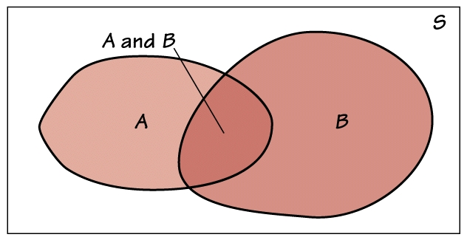
Union
Recall: the union of two or more events is the event that at least one of those events occurs.

Slide 6
Union
Addition Rule for the Union of Two Events:
P(A or B) = P(A) + P(B) – P(A and B)

Slide 7
Intersection
The intersection of two or more events is the event that all of those events occur.

Slide 8
The General Multiplication Rule for the Intersection of Two Events
P(A and B) = P(A) ∙ P(B/A)
is the conditional probability that event B occurs given that event A has already occurred.

Slide 9
Extending the multiplication rule
Make sure to condition each event on the occurrence of all of the preceding events.
Example: The intersection of three events A, B, and C has the probability:
P(A and B and C)
= P(A) ∙ P(B/A) ∙ P(C/(A and B))

Slide 10
Example:
The Future of High School Athletes
Five percent of male H.S. athletes play in college.
Of these, 1.7% enter the pro’s, and
Only 40% of those last more than 3 years.

Slide 11
Define the events:
A = {competes in college}
B = {competes professionally}
C = {In the pros’s 3+ years}

Slide 12
Find the probability that the athlete will compete in college and then have a Pro career of 3+ years.
P(A) = .05, P(B/A) = .017,
P(C/(A and B)) = .40
P(A and B and C)
= P(A)P(B/A)P(C/(A and B))
= 0.05 ∙ 0.017 ∙ 0.40
= 0.00034

Slide 13
Interpret: 0.00034
3 out of every 10,000 H.S. athletes will play in college and have a 3+ year professional life!

Slide 14
Tree Diagrams
Good for problems with several stages.

Slide 15
Example:
A future in Professional Sports?
What is the probability that a male high school athlete will go on to professional sports?
We want to find P(B) = competes professionally.
Use the tree diagram provided to organize your thinking. (We are given P(B/A^{c} = 0.0001)

Slide 16
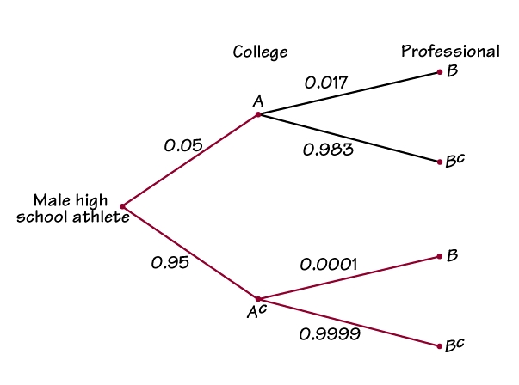
The probability of reaching B through college is:
P(B and A) = P(A) P(B/A)
= 0.05 ∙ 0.017
= 0.00085
(multiply along the branches)

Slide 17
The probability of reaching B with out college is:
P(B and A^{C}) = P(A^{C} ) P(B/ A^{C} )
= 0.95 ∙ 0.0001
= 0.000095

Slide 18
Use the addition rule to find P(B)
P(B) = 0.00085 + 0.000095
= 0.000945
About 9 out of every 10,000 athletes will play professional sports.

Slide 19
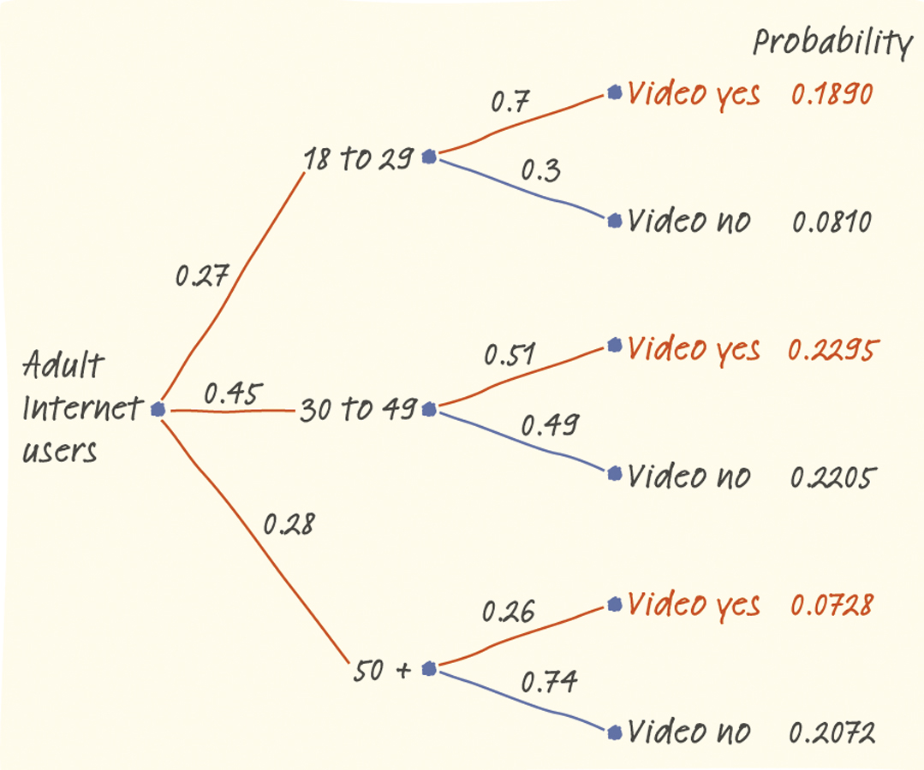
Example: Who Visits YouTube?
What percent of all adult Internet users visit video-sharing sites?
P(video yes ∩ 18 to 29) = 0.27 • 0.7
=0.1890
P(video yes ∩ 30 to 49) = 0.45 • 0.51
=0.2295
P(video yes ∩ 50 +) = 0.28 • 0.26
=0.0728
P(video yes) = 0.1890 + 0.2295 + 0.0728 = 0.4913

Slide 20
Independent Events
Two events A and B that both have positive probabilities are independent if
P(B/A) = P(B)

Slide 21
Extra Time?

Slide 22
Decision Analysis
One kind of decision making in the presence of uncertainty seeks to make the probability of a favorable outcome as large as possible.

Slide 23
Example : Transplant or Dialysis
Lynn has end-stage kidney disease: her kidneys have failed so that she can not survive unaided.
Her doctor gives her many options but it is too much to sort through with out a tree diagram.
Most of the percentages Lynn’s doctor gives her are conditional probabilities.

Slide 24
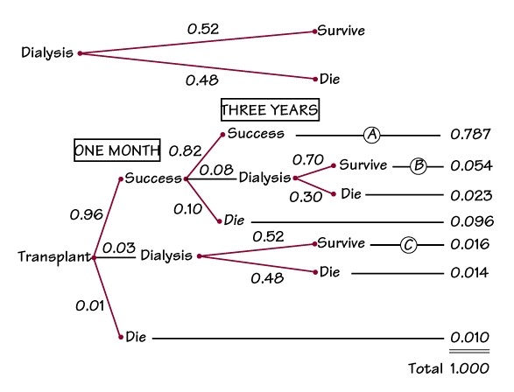
Transplant or Dialysis
Each path through the tree represents a possible outcome of Lynn’s case.
The probability written besides each branch is the conditional probability of the next step given that Lynn has reached this point.

Slide 25
For example: 0.82 is the conditional probability that a patient whose transplant succeeds survives 3 years with the transplant still functioning.
The multiplication rule says that the probability of reaching the end of any path is the product of all the probabilities along the path.

Slide 26
What is the probability that a transplant succeeds and endures 3 years?
P(succeeds and lasts 3 years)
= P(succeeds)P(lasts 3 years/succeeds)
= (0.96)(0.82)
= 0.787

Slide 27
What is the probability Lyn will survive for 3 years if she has a transplant?
Use the addition rule and highlight surviving on the tree.
P(survive) = P(A) + P(B) + P(C)
= 0.787 + 0.054 + 0.016
= 0.857

Slide 28
Her decision is easy:
0.857 is much higher than the probability 0.52 of surviving 3 years on dialysis.

Slide 29
Homework
6.3 Review Exercises: 6.85, 6.88, 6.90, 6.93

