Slide 1
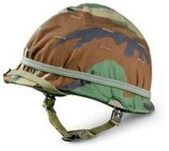
AP Stats: Warm-Up
The army reports that the distribution of head circumference among soldiers is approximately Normal with a mean 22.8 inches and a standard deviation of 1.1 inches. Helmets are mass produced for all except the smallest 5% and the largest 5% of head sizes. What head sizes get custom made helmets?
Shadenorm()

Slide 2
Idea of the Day
Standard deviation and stocks.

Slide 3
Agenda
Today: Assessing Normality and Project time (25 minutes or so).
Friday: Review Day for the Test (Projects Collected)
Monday: No School
Tuesday: Drop
Wednesday: Unit Test (Chapter 2)
Thursday/Friday (no class)

Slide 4
Assessing Normality
Later on this year we will be taking samples from a population and drawing conclusions about the population from which they came.
In order to do this we often make the assumption that the population is approximately normally distributed.
One way to do this:
We can look at a histogram and plot the mean, mean +s and mean – s and see if the observations follow the 68-95-99.7 Rule.
We can also look at a BOXPLOT and see where the median falls relative to the quartiles.

Slide 5
Normal Probability Plot (also called a Quantile Plot)
A plot of the data points against each points’ corresponding z-score.
If the points on a normal probability plot lie close to a straight line, the plot indicate that the data are Normal. LOOK FOR SHAPES THAT SHOW CLEAR DEPARTURES FROM NORMALITY. DON’T OVEREACT TO SMALL WIGGLES.
Outliers appear as points far away from the overall pattern of the plot.

Slide 6
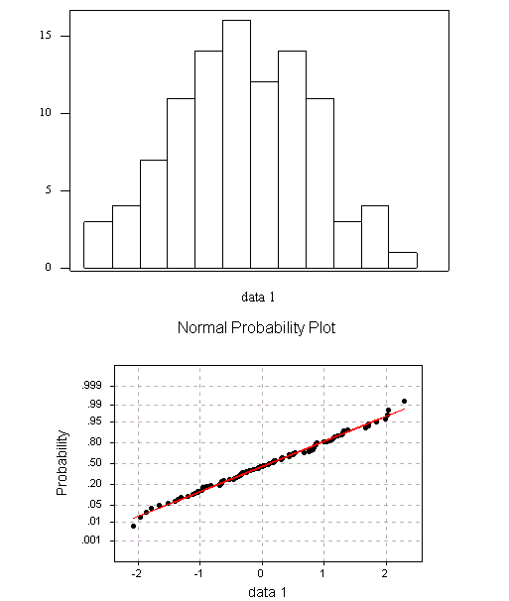

Slide 7
SKEW FOR NORMAL PROBABILITY PLOTS

Slide 8
Using your graphing calc to make a normal prob plot
Teacher's Age
30
28
29
32
27
28
27
28
26
42
25
28
24
26
27
34
GPA
3.92
3.4
3.74
3.8
3.35
4
3.4
3.6
4.1
3.3
3.7
3.1
3.4
3.96

Slide 9
Project Time: Due Tomorrow
Spend the rest of class working on your project. You may go to the computer lab to use Minitab or you may work in the room.
Feel free to ask any clarifying questions about your project.
We will start the day tomorrow reviewing with a group quiz. No need to study. You can use your notes and it will be short just like the last one (an easy 100 and good way to review as well).

