Slide 1
Honors Precalculus: Do Now
1.) Diabetes affects 25.8 million people in the United States, or 8.3% of the population. A simple test is used to determine if an individual has diabetes and the test is 96% accurate (a 4% false positive rate). Given that someone has tested positive for diabetes, what is the probability that the individual actually has diabetes.
2.) Make up a sequence of twenty H’s and T’s that COULD represent a sequence of heads and tails generated by a fair coin

Slide 2
FUN Fact of the Day!
http://nrich.maths.org/7250
The fallacy of the “HOT HAND”.
The difference between STREAKS and INCREASED PERFORMANCE.

Slide 3
So you’re telling me there’s a chance….

Slide 4
Probability
Probability occurs in so many domains of life.
From gambling, to the weather, to election predictions, to physics, medicine, and business.

Slide 5
Discrete Probability
Where there are a finite number of outcomes (i.e tossing a coin or rolling a die)
This is opposed to continuous probability which is a bit more complex and we will deal with later (height, speed etc.).
MUTUALLY EXCLUSIVE: Can’t occur at the same time.

Slide 6
Probability when Flipping a Coin

Slide 7
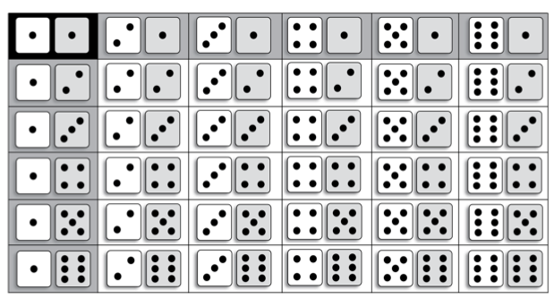
Probability When Rolling 2 dice

Slide 8
SOME BASIC PROBABILITY AND NOTATION

Slide 9
Conditional Probability

Slide 10
Example 1:

Slide 11
- Work Together to Try This One From Your Homework

Slide 12
Practice Together
Start working on the homework together!
These are good problems to work out in teams.

