Slide 1
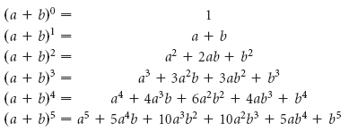
Expanding (a + b)^{n}

Slide 2
Expand (a + b)⁷ using Pascal’s triangle

Slide 3
Expand (2 – 3x)⁵ using Pascal’s triangle

Slide 4

The Binomial Theorem

Slide 5
Example 3: Finding a Particular Term
Find the term that contains x⁵ in the expansion of (2x + y)²⁰

