Slide 1
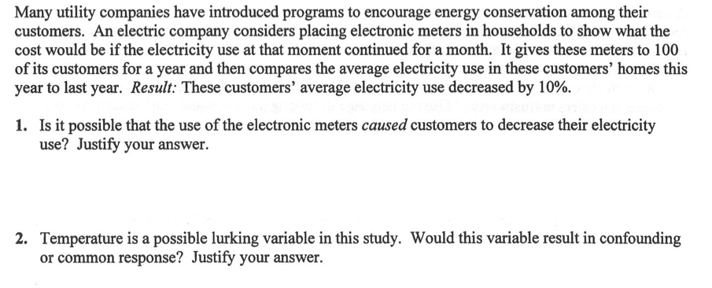
AP STATS: Warm-Up
2.) Think of the following question:
Imagine you could decide between 3 options for your quiz grade on the quiz you just handed in.
Option 1: I grade your quiz normally and what you receive is your grade.
Option 2: You receive the mean grade for the class
Option 3: You receive the median grade for the class.
What would help you decide what option you chose?

Slide 2
Cliffnotes of Chapter 4
Transforming to Achieve Linearity:
x, log (y) : Exponential
log x, log y : Power
Two Way Tables
Simpson’s Paradox: an association or comparison that holds for several OR ALL groups REVERSES when the data are combined to form a single group…
Correlation does NOT imply causation
Common Response
Confounding
Causation

Slide 3
Friday Review Game:
Teams of 2:

Slide 4
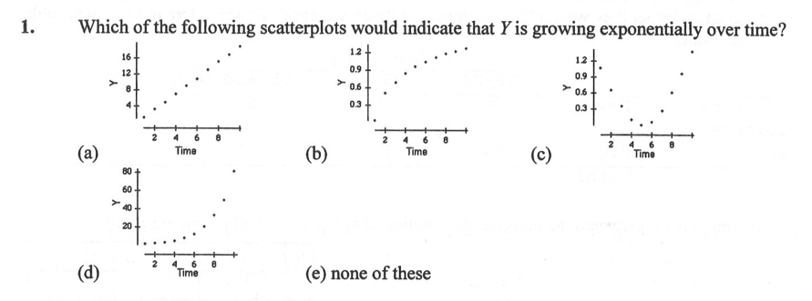
Question 1:

Slide 5
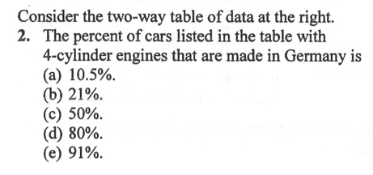
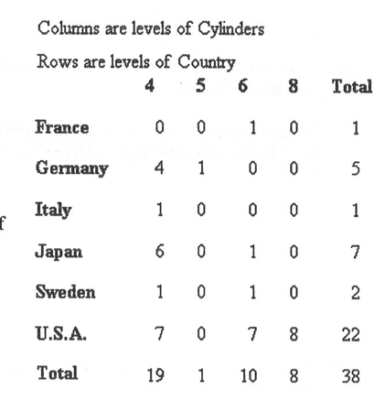
Question 2:

Slide 6
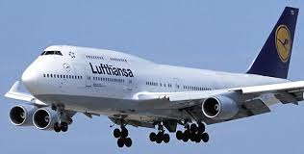
Trivia
How many gallons of fuel can the Boeing 747 hold?

Slide 7
Trivia
How many gallons of fuel can the Boeing 747 hold?
63,034

Slide 8
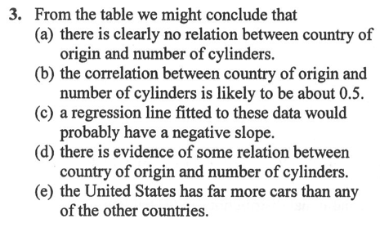
Question 3:

Slide 9
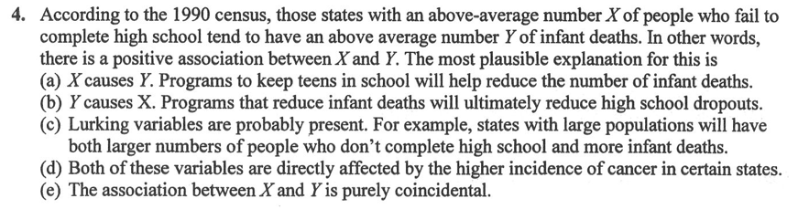
Question 4:

Slide 10
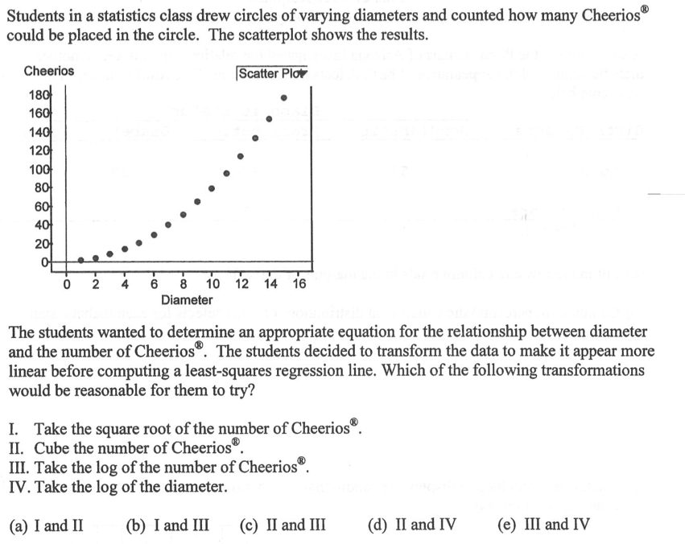
Question 5:

Slide 11
Answers
D, A, D, C, B

Slide 12
Question 6:
A new researcher has found a moderate negative association
between alcohol consumption and lifespan. Is the association most likely
due to causation, confounding, or common response? Justify your answer.

Slide 13
Question 6:
A new researcher has found a moderate negative association
between alcohol consumption and lifespan. Is the association most likely
due to causation, confounding, or common response? Justify your answer.
Confounding

Slide 14
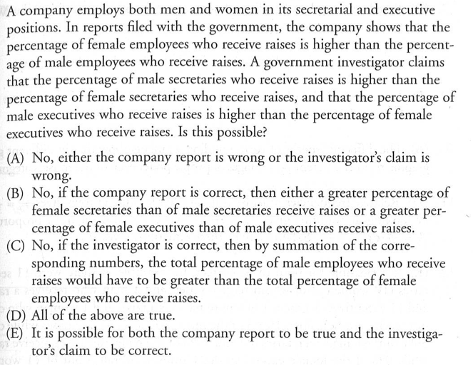
Question 7:

Slide 15
Question 7:
E. 11 secretaries (10 women, 3 receive raises and 1 man receives a raise).
11 Executives (10 men, 1 who receives a raise and 1 woman who does not receive a raise).
3 out of 11 woman receive raises, while only 2 out of 11 men receive raises.

Slide 16
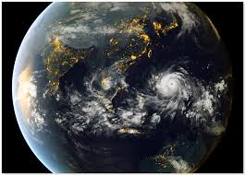
Trivia
Typhoon Haiyan had wind gusts of up to __________ mph?

Slide 17
Trivia
Typhoon Haiyan had wind gusts of up to __________ mph?
235mph

Slide 18
Question 7:

Slide 19
Question 8:

Slide 20
Question 8:
A

Slide 21
Trivia
What is the earth’s circumference in miles?

Slide 22
Trivia
What is the earth’s circumference in miles?
24,901

Slide 23
Question 9:

Slide 24
Question 9:
C, A

Slide 25
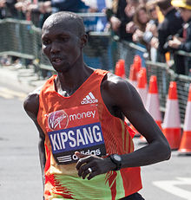
What is the world’s fastest marathon time?

Slide 26
What is the world’s fastest marathon time?
2:03:23

Slide 27
HOMEWORK #29
HW #29: Review for the Chapter 1-4 Test (complete the exercises below)
Chapter 4 Review Exercises: Page 316-319: #4.50, 4.52 (or 4.55 or #1.8 in the cumulative review-your choice ), 4.56
Cumulative Review: Page 320-323: #1.3, 1.4, 1.10
REMINDER: Our CUMULATIVE Test on Chapter 1-4 will be on Wednesday (11/20). The questions will be AP level questions and the format will be similar to our previous tests (half multiple choice and half free response). There will probably be MORE multiple choice questions than our previous tests however (in other words, it will be a bit longer). It will have a slight focus on Chapter 4, but not by much. It will mainly be a mix of problems from Chapter 1-4. The questions will be pulled from practice AP exams on topics that we have covered.
I will be checking HW #26-30 the day of the test (Wednesday).
Study Tips: Start studying this weekend!!
Reread Chapter Summaries (Chapter 1-4) or chapter if necessary
Look at notes/old tests/quizzes.
Complete review problem sets
PowerPoint slides are also online.
We will be doing a more cumulative review on Tuesday.

