Slide 1
AP STATS: Review
We will be doing some review today. Start by working in your group of 4 on the following review problems from your textbook.
6.97, 6.101, 6.102, 6.104, 6.105, 6.108
Reminder: We will be having a Chapter 6 and 7 combined test on Thursday next week.
From an AP Prep Book
37.5%

Slide 2
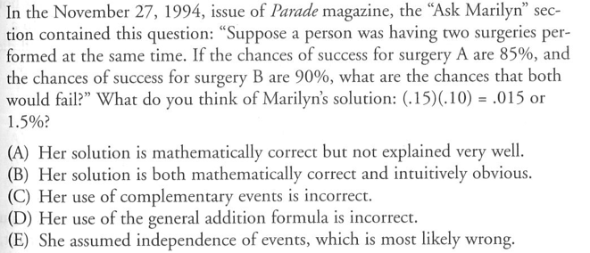

Slide 3
e

Slide 4
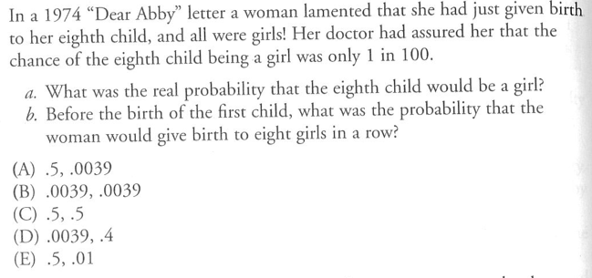

Slide 5
A

Slide 6
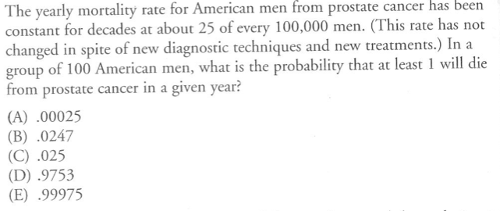

Slide 7
B

Slide 8
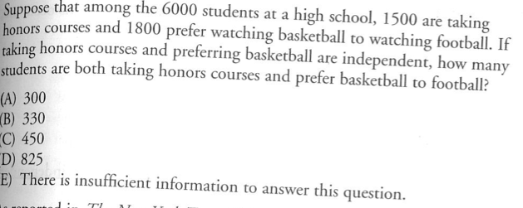

Slide 9
C

