Slide 1
AP Stats: Chi Square
Free Response Question from last year’s AP exam.
Try the free response question from last year’s AP exam. You may use your calculator entirely for the calculations. Feel free to use your notes from yesterday. I will give you the scoring guidelines afterwards so that you can self assess whether you would have gotten a 1, 2, 3, or 4 based on your response.
Field Trip on Monday – we will actually be leaving at 1:30PM that day (your teachers have been emailed. Please leave your 4th period class at 1:30 and come to my room).

Slide 2
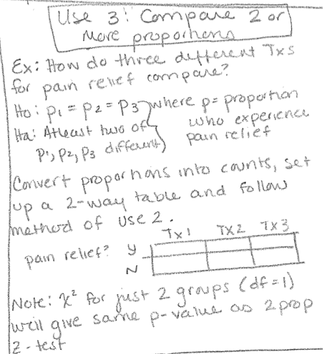

Slide 3
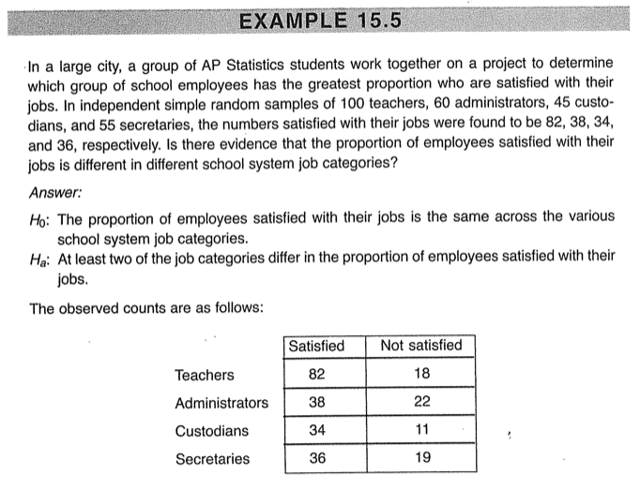

Slide 4
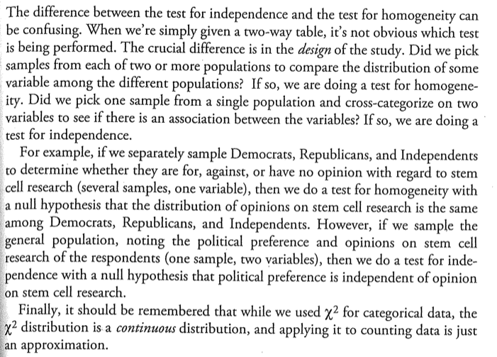
Independence Or Homogeneity?

Slide 5
HW 20
Finish reading the chapter on chi square. Complete the following.
MC 6-10
FR #3 and 5
All solutions online.

