Slide 1
Chi Square
Just two units left!! (chi square and inference for the slope of a regression line). I am going to teach them as one unit (as your AP book does).
-Test next week (Friday probably).
-Monday- Stat Field Trip
-2 weeks of review/poster work/practice AP
Warm-up: Read page 405-408 (through example 15.1) and take notes.

Slide 2
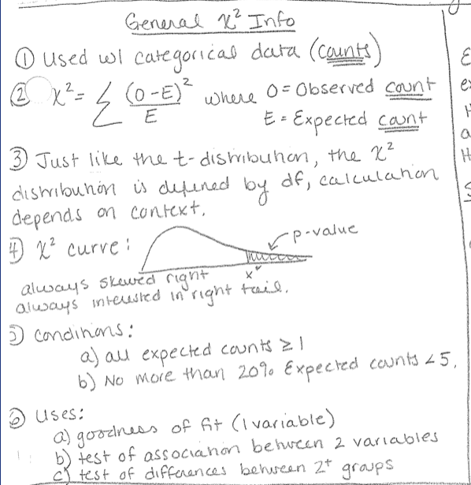
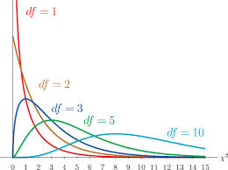
Chi Square

Slide 4
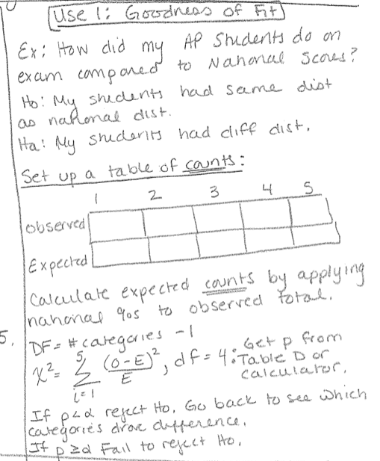
Chi Square Goodness of Fit

Slide 5
Example 15.1 on Calc
Chi square goodness of fit test.

Slide 6
Try Example 15.2
Check your answer as you go.

Slide 7
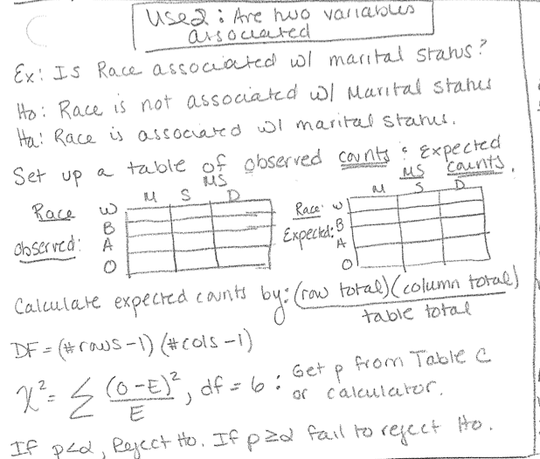
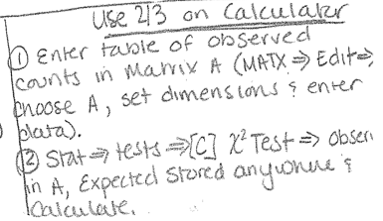
Chi Square for Independence
Read 409-412
(through example 15.3
Example 15.3 on calc

Slide 8
Try example 15.3/15.4
Check your answer as you go.

Slide 9
HW/Classwork
Complete #1-5 MC questions
FR #1

