Slide 1
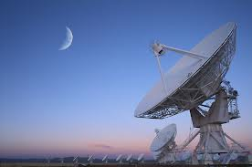
Honors Precalculus: Do Now
1.) A radio telescope in the Very Large Array at Socoro, New Mexico has a shape of a parabolic dish (i.e. the cross section through the center of the dish is a parabola). The dish is 12 ft deep at the center and the dish has a diameter of 82 feet. How far from the vertex of the parabolic dish should the receiver be placed in order to “catch” all the radio waves that hit the dish? i.e. find the Focus (that is where the receiver needs to be placed).
2.) FIND AN EQUATION FOR THE
PARABOLA WITH A VERTEX AT (0,0)
GIVEN THE DIRECTRIX Y = 7. Sketch it.

Slide 2
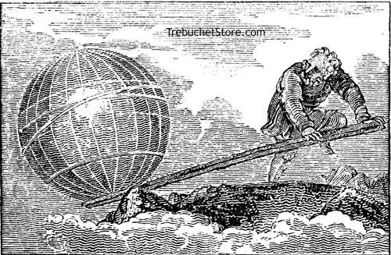
Quote/Video of the Day!
Archimedes (287-212BC)
“Give me a place to stand and a fulcrum for my lever, and I can lift the earth.”
Credited for the formulas for the volume and surface area of a sphere!

Slide 3
Transforming a Parabola
We will look at these in more depth but to give you a preview of what this looks like….
For all conics to transform the vertex from the origin (0,0) simply replace x with (x- h) and replace y with
(y – k). H shifts the graph horizontally and k shifts the graph vertically.
(x – h)² = 4p(y – k) where (h,k) are the coordinates of the vertex.
OR… for a “sideways” parabola.

Slide 4
Example 1: Transforming a Parabola
Determine the vertex, focus, and directrix and sketch the graph of the parabola.
(x + 2)² = 12(y - 3)

Slide 5
Example 2: Transforming a Parabola
Determine the vertex, focus, and directrix and sketch the graph of the parabola.
X² – 4x = 8y - 28

Slide 6
Now let’s look at a circle.
A circle is the set of points that are equidistant from the center. The distance from the center to any point as you know is called the radius.
Equation of a circle (with vertex at (0,0)):
x² + y² = r²
^{OR}

Slide 7
With Transformations of the Center.
where (h, k) is the center.
(x - h)² + (y - k)² = r²

Slide 8
Example 1: Circles
Find the radius and center of each of the circles given.
x² + y² = 49
(x- 4)² + (y+7)² = 7
x² – 2x + y² – 6y = 9

Slide 9
Example 2: Another Circle Problem
Determine whether the line 3x + 2y = 6 contains the center of the circle
x² + y² + 4x – 12y + 24 = 0.

Slide 10
Example 3:
Find the length of a tangent line segment from (10, 5) to the circle x² + y² = 25.

Slide 11
Example 4: Write the Equation
Write an equation of the circle described below
a.) The center is (2,3) and the circle passes through (5,6).
b.) The center is (-3,1) and the circle is tangent to the line x=4.

Slide 12
Example 4: Write the Equation
Write an equation of the circle described below
c.) The circle is tangent to the x-axis at (4,0) and has y-intercepts at -2 and -8.

Slide 13
HW #3/4: Circles/Ellipses Problem Set
Start working on the problem set in pairs. We will be looking at ellipses tomorrow which are very similar to the equation for a circle (don’t start those until tomorrow).
This problem set will count as 2 homeworks
(20 points).

Slide 14
Honors Precalculus: Do Now

Slide 15
Ellipse
The set of all points in the plane the sum of whose distances from two fixed points F₁ and F₂ is a constant. These two points are the foci. The midpoint of F₁ and F₂ is the center.

Slide 16
Equation of an Ellipse
Foci on the x-axis
Foci on the y-axis
a>b>0
a>b>0
Vertices (a, 0) and (-a, 0)
Foci (c, 0) and (-c, 0): c² = a² – b²
Length of major axis: Horizontal: length = 2a
Length of minor axis: vertical: length = 2b
Vertices (0, a) and (0, -a)
Foci (0, c) and (0, -c): c² = a² – b²
Length of major axis: vertical: length = 2a
Length of minor axis: horizontal: length = 2b

Slide 17
Example 1: Sketching an Ellipse
An ellipse has the equation:
a.) Find the foci, vertices, and the lengths of the major and minor axis, and sketch the graph.

Slide 18
Example 2: Finding the Foci of an Ellipse
Find the foci of the ellipse 16x² + 9y² = 144 and sketch it’s graph.

Slide 19
Example 3: Finding the equation of an Ellipse
The vertices of an ellipse are (4, 0) and (-4, 0) and the foci are (2, 0) and (-2, 0). Find its equations and sketch the graph.

Slide 20
Example 4: Shifted Ellipses
Sketch the graph of the ellipse:

Slide 21
Eccentricity of an Ellipse
Eccentricity measures the deviation of an ellipse being circular by the ratio of a and c.
Where
Eccentricity is always between 0 and 1.

Slide 22
Examples of Eccentricity:
e=0.1 e = 0.5 e=0.68 e=0.86

Slide 23
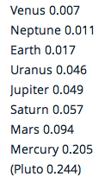
Example 4: Finding the equation of an ellipse from its Eccentricity and Foci
Find an equation of an ellipse with foci (0, +/-8) and eccentricity e=4/5

