Slide 1
AP STATS: Quiz Quick Warm-up
You take an SRS of 65 American Adults to determine the mean income of Americans from this sample. The mean income for these adults was $27,500. Assume that we know the population standard deviation (σ) to be $6,500
1.) Conduct a 95% confidence interval for the mean income of all American adults using this sample (be sure to check that the conditions are met).
2.) Properly interpret this Conf. Interval.
Parameter? Conditions? Calculations? Interpretation?

Slide 2
Quiz Time
Take 10 minutes to complete the quiz.
#4 is extra credit (2%) though not that hard…

Slide 3
End of 10.1:Determining Sample Size
Once again, the SIZE OF THE POPULATION does NOT influence the sample size needed

Slide 4
Cautions:
Garbage in, Garbage Out…. Confidence Intervals are only meaningful when the data was properly collected (i.e. nonresponse, undercoverage, response bias, etc. all influence the data). Fancy formulas can’t rescue bad data.
MUST BE FROM AN SRS
Outliers can distort results. Think about removing them.
The shape of the population distribution matters (when n is small). When n ≥15, the confidence level is not greatly effected by the shape of the population.

Slide 5
10.2 Estimating a Population Mean
What about when we don’t know σ? More realistic.
Conditions must still be met:
1.) SRS – other types of samples require slightly different techniques that we won’t discuss here.
2.) Normality – observations from the population should be normal or approximately normal. It is enough that the distribution is symmetric and single peaked unless the sample is small.
3.) Independence or N≥10n
Estimate σ with s and estimate the standard deviation of the sampling distribution with
s/√n which is called the STANDARD ERROR.
Also, we use the t-distribution to get critical t-scores instead of using the z-distribution as we could do when we knew σ

Slide 7
Degrees of freedom
t(n – 1) – always round down
Spread is a bit greater
than the z-distribution
because there is more
variance since we don’t
knowσ

Slide 8
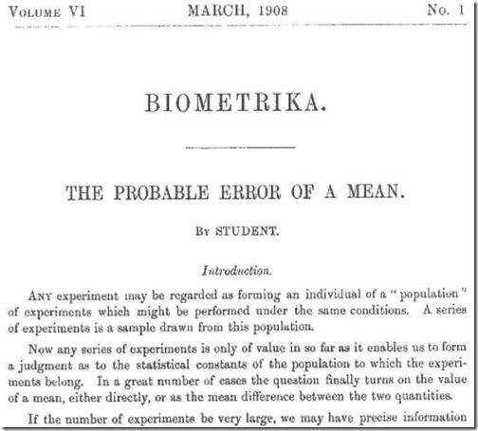
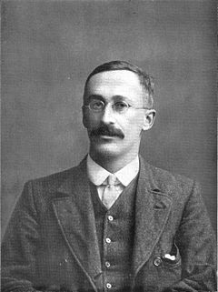
Who is STUDENT anyways?
Student’s t-distribution (William Sealy Gosset).
When Gosset joined Guinness, Dublin, his task was to perfect the process of brewing beer.
The principle was that one had to add an exact amount of yeast colonies to a certain amount of fermenting barley to turn it into beer. Too few colonies and the brew would be incompletely fermented and too much, it would become bitter.
Gosset was taking small samples and trying to extrapolate his findings to large populations. Before Gosset it was thought that you needed a large sample to determine population parameters. Gosset discovered that you could STILL determine population parameters with a certain amount of certainty using SMALL samples.

Slide 10
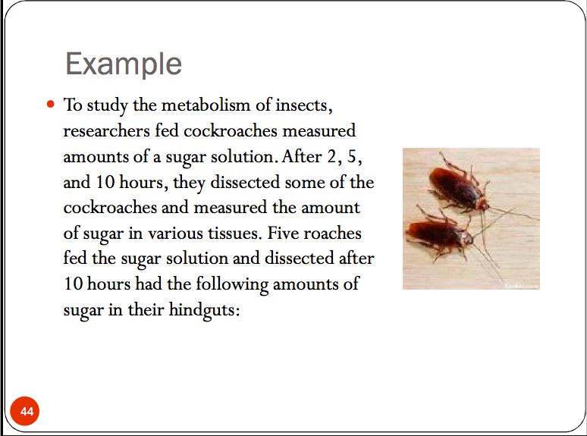

Slide 11
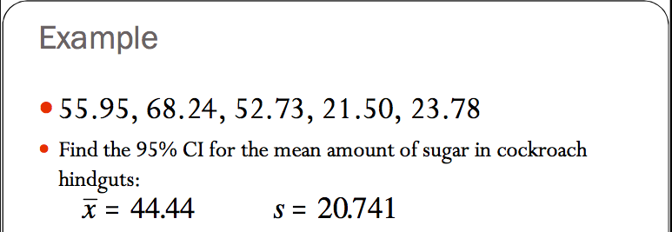

Slide 12
Construct a 95% Confidence Interval for the mean amount of NOX emitted by light duty engines of this type. Parameter? Conditions? Calculations, Interpretation.

Slide 13
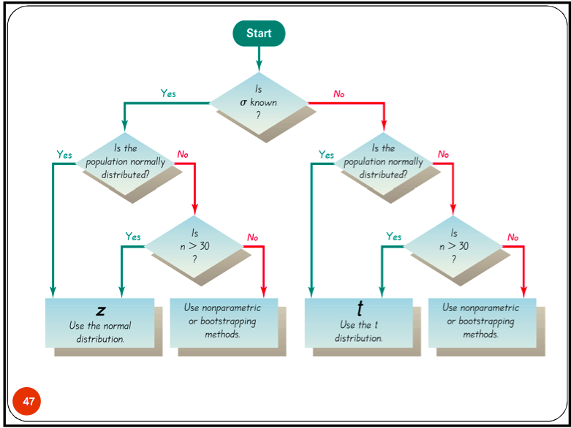

Slide 14
HW #6
Read section all of section 10.2
(be ready to go full steam ahead with confidence intervals on Tuesday)
Complete exercises 10.27, 10.28, 10.31

