Slide 1
Construct a 95% Confidence Interval for the mean amount of NOX emitted
by light duty engines of this type.
Parameter? Conditions (SRS, NORMALITY, INDEPENDENCE)? Calculations, Interpretation.
Also, practice making a histogram and boxplot of this data.

Slide 2
What does 90% confident actually mean?
We are using a method that captures the true population mean in 90% of all samples of this size.
If the procedure were repeated many times, 90% of the confidence intervals would contain the TRUE population mean.

Slide 3
Some calculator tips
T-intervals
Z-intervals
invT(% to the left, degrees of freedom)
invT(.975, 45)

Slide 4
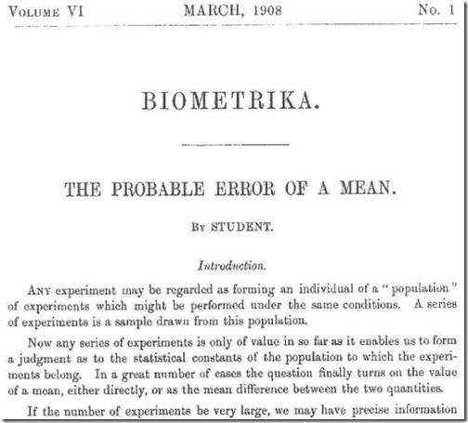
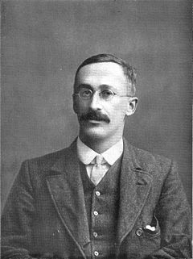
Who is STUDENT anyways?
Student’s t-distribution (William Sealy Gosset).
When Gosset joined Guinness, Dublin, his task was to perfect the process of brewing beer.
The principle was that one had to add an exact amount of yeast colonies to a certain amount of fermenting barley to turn it into beer. Too few colonies and the brew would be incompletely fermented and too much, it would become bitter.
Gosset was taking small samples and trying to extrapolate his findings to large populations. Before Gosset it was thought that you needed a large sample to determine population parameters. Gosset discovered that you could STILL determine population parameters with a certain amount of certainty using SMALL samples.

Slide 5
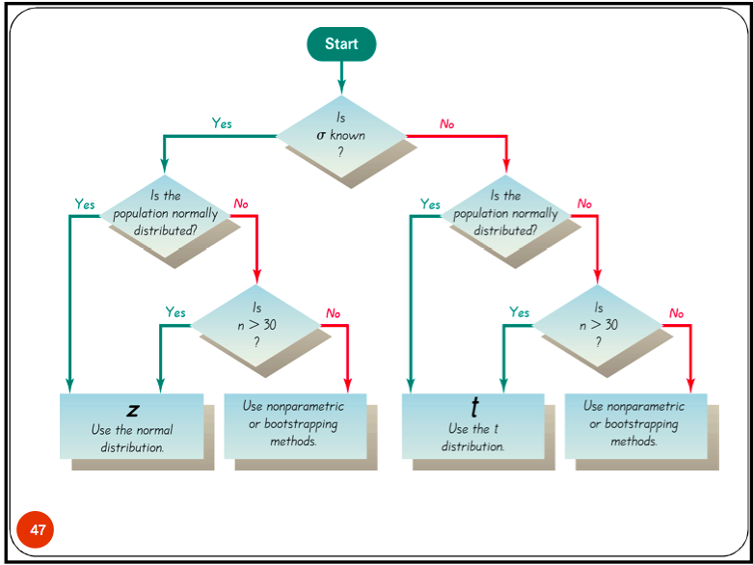

Slide 6
Paired t Procedure
Oftentimes we are interested in comparing two treatments (i.e. placebo versus treatment).
Paired t-procedure:
To compare the responses to two treatments in a matched pairs design or before-and-after measurements on the same subjects, apply one sample t procedures to the observed differences.
Parameter of interest?
Mean difference between groups (or matched pairs)

Slide 8
Random Assignment vs. Random Selection
Random assignment: Let’s us see whether there was a treatment effect.
Random Selection: Allows us to generalize the findings.
When we do inference later, we will see that we are oftentimes not doing a matched pairs design but are instead taking two independently chosen samples and giving one group the treatment and the other a placebo.

Slide 9
Robust Procedures
An inference procedure is said to be robust, if the probability calculations involved in that procedure remain fairly accurate WHEN A CONDITION FOR THE USE OF A PROCEDURE IS VIOLATED.
i.e. the confidence interval is still pretty accurate
T-procedures are NOT robust against outliers (because they impact both the mean and standard deviation).

Slide 10
Remember though… if you’re data is biased, you might as well not even conduct a
T-interval. GIGO!!

Slide 11
HW #7
Finish reading section 10.2
I’ll give you a take home quiz tomorrow which you’ll start as part of your warm-up.
Complete exercises 10.37, 10.39, 10.40, 10.41
Read the excerpt from Nate Silver’s Book.

