Slide 1
AP STATS: Warm-Up
Spend 5 minutes working on the take-home quiz. You may use your notes and textbook and may even touch base with your classmate sitting next to you. You will finish the quiz as part of your homework.
When your quiz says to use the Inference Toolbox that means Parameter, Conditions, Calculations, and Interpretation.
Agenda:
Thursday: Take Home Quiz on 10.3 (due Friday) then Review/Collect a bit of Data
Friday: Computer Lab to Analyze our data
Monday: Chapter 10 Test

Slide 2
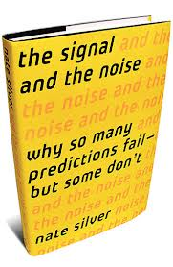
The Signal and the Noise
I gave you a short reading from a chapter from Nate Silver’s book. Take a few minutes
to read it over.
It is a fantastic read and really covers everything that we have covered in this
class in some capacity. I think you will truly find it interesting and enlightening,
especially with your background from this class.

Slide 3
10.3 Confidence Intervals for Proportions
Let’s say that you want to determine the percent of Rhode Island voters who vote democratic?
Or the percent of Moses Brown students who approve of Barack Obama’s… I mean Josh Jasper’s Presidency?
Or the percent of Ipads being produced with a manufacturing flaw?
Or the percent of MB students who watched the U.S. beat Russia in hockey this past weekend?
Or the percent of US residents who have access to the internet at home?
We can use a confidence interval to do this. Same exact thing but now for PROPORTIONS!!

Slide 4
Let’s take a simple example…
Let’s say that we want to know the percent of Valentine’s day candy that has a “manufacturing flaw” i.e. the hearts are missing a part of their message?
Let’s take a sample and use it to create a 95% CI for the percent of all hearts made by this company that have a flaw.

Slide 5
A few reminder’s about the sampling distribution for proportions from 9.2

Slide 6
Don’t forget about GIGO though… surveys might suffer from this.
OR…
Do a 1-Prop Z Test on your TI-84

Slide 7

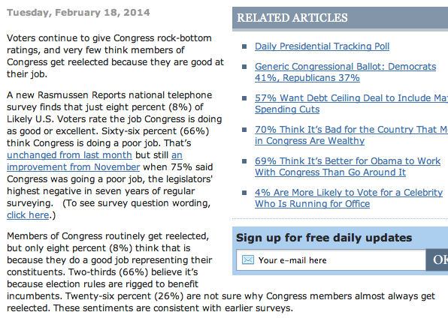

Slide 8
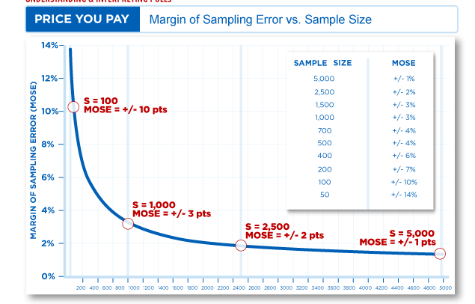
Why 1000 people?
Also, remember, as long as N ≥ 10n then the population size doesn’t matter,
Just the sample size. That means an unbiased sample of the US can provide very accurate
results of ALL Americans with just a sample of 1000 people.

Slide 9
Sample Size
Let’s say that you are put in charge of determining the percent of Rhode Island voters that are satisfied or very satisfied with Sheldon Whitehouse. You want your estimate to be within 2.5% of the true value with a 95% confidence level. How many people should you survey?

Slide 10
HW #8: Confidence Intervals for Proportions
Exercises: 10.57, 10.58, 10.59
Quiz Tomorrow on 10.3 (take home-due Friday).

Slide 11
Robust Procedures
An inference procedure is said to be robust, if the probability calculations involved in that procedure remain fairly accurate WHEN A CONDITION FOR THE USE OF A PROCEDURE IS VIOLATED.
i.e. the confidence interval is still pretty accurate.
T-procedures are NOT robust against outliers (because they impact both the mean and standard deviation).
T-Procedures ARE robust against non-normality (especially when n is large – CLT)

