Slide 1
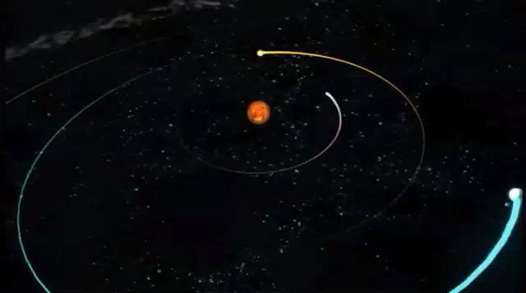
Conic sections project
Ellipses
Kelsey Whelan

Slide 2
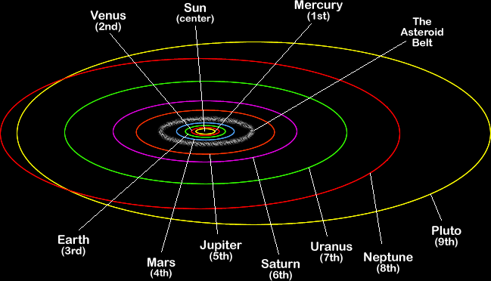
What is an Ellipse?
Think of it as a squashed circle
The oval path is centered around the foci, two points equidistant from the center
REFLECTIVE PROPERTY: A strait line drawn from a focal point to any point on the ellipse back to the other focal point has the same length as any point on the ellipse

Slide 3
Equation of an Ellipse
When the foci are on the x-axis the equation is: (x²/a²)+(y²/b²)=1
Vertices: (a, 0) (-a, 0)
Foci: (c, 0) (-c, 0)
Length of horizontal major axis: 2a
Length of vertical minor axis: 2b
When the foci are on the y-axis the equation is: (y²/a²)+(x²/b²)=1
Vertices: (0, a) (0, -a)
Foci: (0, c) (0, -c)
Length of major vertical axis vertical: 2a
Length of horizontal minor axis: 2b

Slide 4
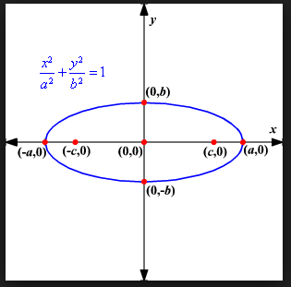
Foci
The foci are always on the major axis, equidistance from the center
They can be found using the formula c² = a² – b²
Using the elliptical equation : (x²/a²)+(y²/b²)=1 for a and b where the Foci are (c, 0) and (-c, 0)
Using the elliptical equation : (y²/a²)+(x²/b²)=1 for a and b where the Foci are (0, c) and (0, -c)

Slide 5
Vertices
The vertices on an ellipse are the furthest point on the major axis
They can be found by using (a, 0) and (-a, 0) from the elliptical equation : (x²/a²)+(y²/b²)=1
They can be found by using (0, a) and (0, -a) from the elliptical equation : (y²/a²)+(x²/b²)=1

Slide 6
Major and minor axis
Using the ellipse equation (x²/a²)+(y²/b²)=1
The Length of the major horizontal axis is equal to 2a
The Length of the minor vertical axis is equal to 2b
Using the ellipse equation (y²/a²)+(x²/b²)=1
The Length of the major vertical axis is equal to 2a
The Length of the minor horizontal axis is equal to 2b

Slide 7
Eccentricity
The eccentricity is the variation of an ellipse from being perfectly circular
Its always between 0 and 1 and can be found by e=c/a
C²=a²-b²

Slide 8
Graphing an ellipse
Use the equation to find the foci, vertices, and major/minor axis
Then plot them on your graph

Slide 9
Example
Equation : (x²/2²)+(y²/1²)=1
A=2, B=1
Vertices: (2,0) (-2,0)
Foci: c²=a²-b², c²=2²-1², c=(sq rt 3/-3,0)
Length of major axis (horizontal): 2a=4
Length of minor axis (vertical): 2b=2
Eccentricity: e=c/a, e=(sq rt 3/2)

Slide 10
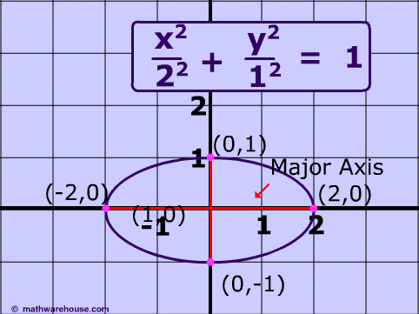
Example continued
Now lets graph it!

Slide 11
Shifting Ellipses
Some ellipses are not centered on (0,0)
These equations look like this
((x-h)²/a²)+((y-k)²/b²)
(h,k) is the new center of the ellipse

Slide 12
Example of shifted ellipse
((x-1)²/9)+((y+2)²=1
A=3, B=1
Center: (h,k), (1,-2)
Vertices: (-2,-2), (4,-2)
Notice that the y coordinate changed with the center change
Foci: c²=a²-b², c²=9-2, c=(sq rt 7+1, -2) (sq rt -7+1, -2)
Notice both the x and y coordinates were shifted to the new center
Length of major (horizontal) axis: 2a= 6
Length of minor (vertical) axis: 2b= 2
Eccentricity: e=c/a, e=(sq rt 7/3)

Slide 13
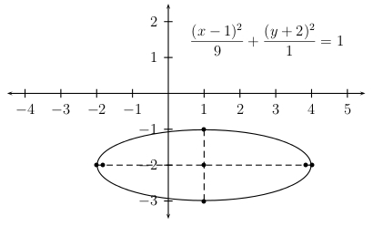
Example of shifted ellipse cont.
Now lets graph it!

Slide 14
Real life Ellipse
A real life example of an ellipse is earth, and all planets orbit around the sun

Slide 15
CONGRADULATIONS!
Now you can graph Ellipses!

Slide 16
Credit
http://www.mathwarehouse.com/ellipse/equation-of-ellipse.php
http://jwbales.us/precal/part9/part9.2.html
http://hotmath.com/hotmath_help/topics/ellipse.html
http://science.howstuffworks.com/29276-100-greatest-discoveries-elliptical-orbits-video.htm
http://suhailrafidi.wordpress.com/2012/08/10/how-johannes-kepler-helped-land-curiosity-on-mars/

