Slide 1
Honors Precalc: Do Now
Do Now Option 1:
Design something using a conic section (parabola, ellipses, circles, and hyperbolas).
i.e. make up an interesting use of a conic section (you can create something that has already been made. It doesn’t have to be novel). For example the eurodish that is a parabolic engine (or the elliptical tub for sound-blasting kidney stones.)
Or it could be an architectural design with a conic section somewhere in the mix.
Draw your design.
DO NOW OPTION 2: Draw a Heart on Your Graphing Calculator
(The Valentine’s Day Throwback)
Step 1)Go to 2nd, Format, AxesOff.
Step 2)Go to Window. Set the following.
Xmin=-1.88
Xmax=1.88
Ymin=-1.2
Ymax=1.7
Leave the others alone.
Step 3)Go to Y=, and set the following

Slide 2
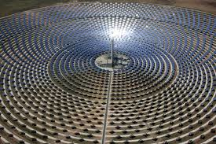
Video/Idea of the Day!
http://www.youtube.com/watch?v=VQxyceFyRCc

Slide 3
Project 1 of the second semester (Due March 7th)!!
You will be creating a video, PowerPoint, or some sort of multimedia presentation (prezi etc.) demonstrating the properties of ONE conic section (parabola, ellipse, circle, or hyperbola).
Think a Khan Academy type of video (but you can get creative with it if you like). Or you could do a PowerPoint or another type of multimedia presentation. I am very flexible. Have fun with it – just make sure you convey what your conic section is, the important properties, and a practical use of the conic section.
You may work in groups of up to 4 people (students from my other 3 classes work as well). Or you may work alone.
You will show someone who has never seen this conic section all the important properties of this conic section, and an interesting application of the conic section.
I will post these online on my website (unless you don’t want me to) so that you have them as a resource when studying for the final. Or just for a good laugh!

Slide 4
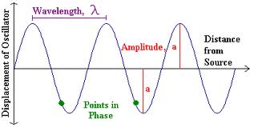
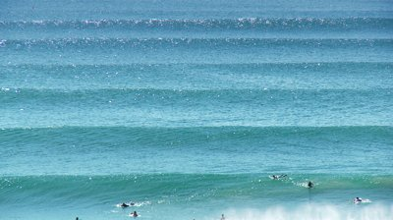
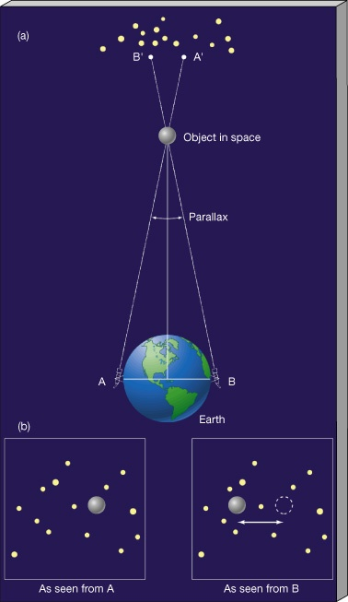
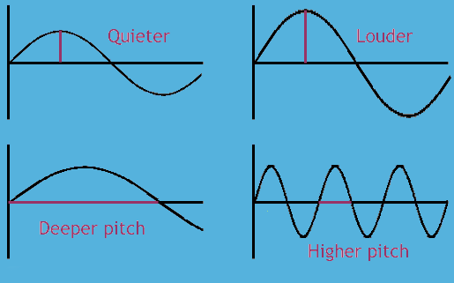
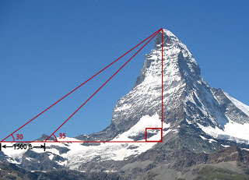
Why Trig?
Surveying: It provides the key relationship between angles and distances (i.e. measuring
The height of tall and far away objects- including the planets).
Modeling periodic functions: Sound waves, light waves, ocean swells, pendulums, etc. anything that rises and falls periodically.

Slide 5
Angles:
Initial side and terminal side (positive angle/negative angle)

Slide 6
Radians Versus Degrees
Degrees: 1 degree = 1/360th of a circle!
If a circle has a radius of 1 than a radian is the length of the arc that subtends the angle.

Slide 7
Relationship Between Radians and Degrees
180°= π radians So… 1 rad =
To convert degrees to radians, multiply by
To convert radians to degrees, multiply by

Slide 8
Example 1
a.) Express 60° in radians
b.) Express radians as degrees
NOTE: When no unit is given on an angle. The assumption is radians!

Slide 9
Standard Position/Coterminal Angles
STANDARD POSITION (vertex at the origin and initial side is on the x-axis).
Two angles in STANDARD POSITION are Coterminal if their sides coincide.

Slide 10
Example 2: Coterminal Angles
a.) Find angles that are coterminal with the angle in standard position.
b.) Find angles that are coterminal with the angle in standard position
c.) Find an angle with measure between 0° and 360° that is coterminal with the angle measure of 1290° in standard position.

Slide 11
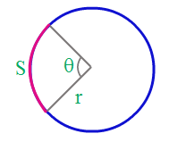
Length of a Circular Arc
In a circle of radius r, the length s of an arc that subtends a central angle of θ radians is
so

Slide 12
Example 3: Arc Length and Angle Measure
a.) Find the length of an arc of a circle with radius 10m that subtends a central angle of 30°.
b.) a central angle θ in a circle of radius 4 m is subtended by an arc of length 6m. Find the measure of θ in radians.

Slide 13
Area of a Circular Sector
In a circle of radius r, the area A of a sector with a central angle of θ radians is:

Slide 14
Example 4: Sector Area
Find the area of a sector of a circle with central angle 60° if the radius of the circle is 3m.

Slide 15
HW #6: Section 6.1
Read section 6.1
6.1: pg. 440-441
#3, 4, 8, 13, 15, 17, 23, 27, 30, 33, 39, 45, 51, 52, 61

