Slide 1
Honors Precalc: You will do HALF
1.) Take three letters ABC and WRITE OUT all the permutations of these three letters (i.e. all the different arrangements of these letters). Than use math to determine how many permutations there are.
2.) Rhode Island has made a smaller statewide lottery with some better odds. You pick 4 numbers from a bin of 25 white balls (no repetitions) and 1 Purple Ball from a bin of 15 purple balls. To win the jackpot you must match the 4 white balls (in any order) and the purple ball. What are the odds of winning the jackpot. What is the expected value of a ticket that costs $1 if the jackpot is currently $100,000? How much should the ticket cost for the game to have an expected value of zero?
3.) How many ways are there to pick a group of 12 people to go on a trip to Hawaii from a group of 130 people?
4.) How many ways are there to arrange the letters in the word
MATH? How about AARDVARK?
5.) A PIN for an ATM card consists of 4 digits (repetition allowed). How many pin numbers are possible?

Slide 2
Quiz Questions
Independence: The probability of one thing does NOT impact the probability of the next.
Dependent: The probability of one thing happening DOES impact the probability of the other event.

Slide 3
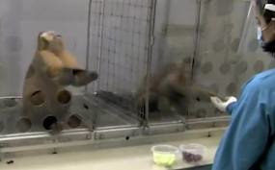
Video of the Day!
http://www.upworthy.com/2-monkeys-were-paid-unequally-see-what-happens-next-sc4-3a

Slide 4
Continuous Probability and Measures of Central Tendency.
Below is the data for the number of points that Iguodala had in his last 12 games.
9, 12, 15, 16, 17, 18, 20, 22, 22, 28, 31, 32
Find the mean, median, mode and range

Slide 5
The Standard Deviation and Variance
The standard deviation is a measure of SPREAD of the data. It measures the amount of dispersion (or variance) from the mean.
The standard deviation for a population.
The standard deviation for a sample.
Simple Example: 2, 3, 10 Then with your calculator.

Slide 6
Example 1:
The following are the scores on the last quiz for my algebra 2 class.
62, 74, 78, 85, 86, 90, 93, 95, 97, and 99
Calculate the mean, standard deviation, and variance.

Slide 7
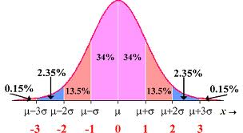
The Normal Curve: 68-95-99.7 Rule

Slide 8
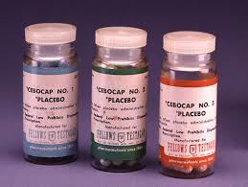
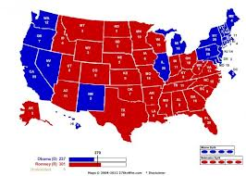
Why we care?
The normal distribution is used on a regular basis to determine the significance of statistical results!!!
Every type of medicine on the market has been rigorously tested using placebo and treatment conditions.
Additionally, we can use these results to calculate CONFIDENCE INTERVALS (which allow us to estimate the mean of a population from a sample with a certain margin or error.) This is used for quality control in nearly
every industry producing goods.
Finally the normal curve allows us to calculate
percentiles given the mean and standard deviation

Slide 9
Example 2:
The life of an energizer battery is normally distributed with a mean μ = 600 hours and standard deviation σ = 100 hours. What is the probability that a battery selected at random will last from 600 to 700 hours?

Slide 10
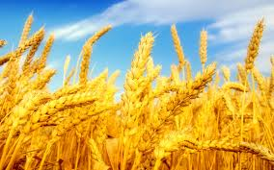
Example 3:
The yearly wheat yield per acre is normally distributed with a mean μ = 35 bushels and standard deviation σ = 8 bushels. What is the probability that an acre selected at random will yield between 19 and 35 bushels?

Slide 11
Example 4:
Vending Machine: Soft Drinks A vending machine automatically pours soft drinks into cups. The amount of soft drink dispensed into a cup is normally distributed with a mean of 7.6 ounces and a standard deviation of 0.4 ounces.
a.) Estimate the probability that the machine will overflow an 8-ounce cup?
b.) Estimate the probability that the machine will NOT overflow an 8ounce cup?
c.) The machine has just been loaded with 850 cups. How many of these do you expect will overflow when served?

Slide 12
Check your Pulse…
Let’s collect some real time data and determine the mean, std. deviation and variance.

Slide 13
HW #31:The standard deviation, variance and normal distribution.
Get started on your HW

