Slide 1
AP STATS: Cumulative Review
Work in groups on the review multiple choice problems handed out from our textbook.
I will go over a few important details to think about for the test, how the test will be scored, and some review topics.

Slide 2
Answers
1.) D
2.) A
3.) E
4.) A
5.) C
6.) A
7.) E
8.) E
9.) D
10.) C

Slide 3
CUMULATIVE TEST TOPICS
Chapter 1: Exploring Data
Displaying Distributions with Graphs (stemplots, histograms, boxplots, ogives etc.)
-Describing Distributions with Numbers (mean, median, standard deviation quartiles etc.)
Chapter 2: Describing Location in a Distribution
-Measures of relative standing and density curves
-Normal Distributions (z-tables)
Chapter 3: Examining Relationships Between 2 Variables
-Scatter Plots
-Linear Regressions(least squares)
-Correlation (r) and Correlation of determination (r-squared).
-Residual: y-hat = actual - predicted
Chapter 4: More about Relationships between 2 Variables
-Transforming to Achieve Linearity (x, log y) (log x, log y) etc.
- Categorical Variables (two way tables, marginal distributions,
-Establishing Causation (Correlation does NOT imply causation)

Slide 4
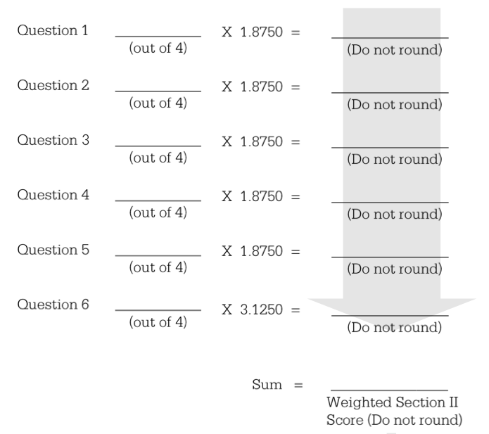
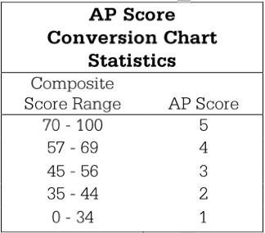
AP STATISTICS SCORING

