Slide 1
AP Stats: Warm-up
Complete the 6.3 “quiz” with the person sitting next to you as your warm-up.
We will be starting our intro to Chapter 7 today: Discrete and Continuous Random Variables.

Slide 2
A Random Variable
A random variable is a variable whose value is a numerical outcome of a random phenomenon .
(Usually denoted by Capital letter like X and Y (of course x-bar might be the most famous and important).
For example. X could be the count of heads when flipping a quarter 4 times.

Slide 3
Discrete Random Variables
Discrete Random Variable: Has a countable number of possible values.
A probability distribution of a discrete random variable lists the values and their corresponding probabilities. We could make a probability histogram with this info.
The probabilities must be between 0 and 1 and
The sum of the probabilities must be 1.

Slide 4
Discrete Random Variable Examples
Random Variable
Possible Values
Experiment
Make 100 Sales Calls
# Sales
0, 1, 2, ..., 100
Inspect 70 Radios
# Defective
0, 1, 2, ..., 70
Answer 33 Questions
# Correct
0, 1, 2, ..., 33
Count Cars at Toll
# Cars
0, 1, 2, ..., ∞
Between 11:00 & 1:00
Arriving

Slide 5
Discrete Probability Distribution Example
Experiment: Toss 2 coins. Count number of tails.
Probability Distribution
Values, x Probabilities, p(x)
0 1/4 = .25
1 2/4 = .50
2 1/4 = .25
© 1984-1994 T/Maker Co.

Slide 6
Visualizing Discrete Probability Distributions
Listing
Table
{ (0, .25), (1, .50), (2, .25) }
f(x)
p(x)
# Tails
Count
0
1
.25
1
2
.50
Graph
2
1
.25
p(x)
.50
.25
n
.00
x
!
p
(
x
)
=
p^{x}(1 – p)^{n – x}
0
1
2
x!(n – x)!
Notes:
Experiment is tossing 1 coin twice.

Slide 8
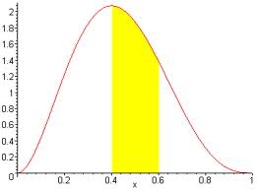
Continuous Random Variable
Random variables that can assume values corresponding to any of the points contained in one or more intervals (i.e., values that are infinite and uncountable) are called continuous.
The probability distribution of X is described by a density curve and the corresponding probabilities have to do with the area under the curve. There is no area at a single point (it must be an interval!!) – This means that it doesn’t matter if you write > or ≥ as they are the same for continuous variables.

Slide 9
Continuous Random Variable Examples
Random Variable
Possible Values
Experiment
Weigh 100 People
Weight
45.1, 78, ...
Measure Part Life
Hours
900, 875.9, ...
Amount spent on food
$ amount
54.12, 42, ...
Measure Time
Inter-Arrival
0, 1.3, 2.78, ...
Between Arrivals
Time

Slide 10
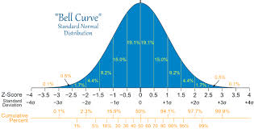
The Normal Curve as a Density Curve
N ( mean, std. deviation)
Table A tells us the area under the curve for various intervals.

Slide 11
HW 37
Read section 7.1
Complete Exercises 7.11 (b-e), 7.12, 7.13, 7.14 7.16, 7.20 (use Table A)
Quiz on 7.1 on Monday.

