Slide 1
Honors Precalculus: Do Now
Find the exact value of the following.
sin (105°)
Cos (195°)
Prove the identity using the sum and difference formula for the tangent.
sec (π/2 – u) = csc (u)

Slide 2
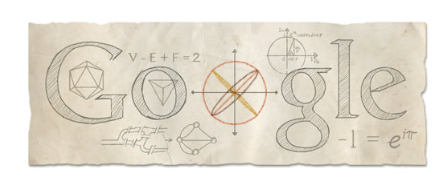
Video of the Day!
Agenda:
Test Tuesday (4/29)

Slide 3
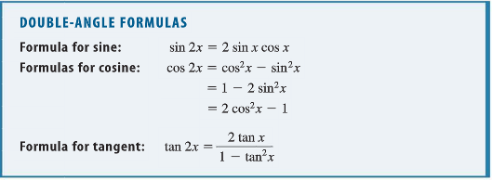
Double Angle Formulas
Used frequently in calculus to differentiate and integrate a function.

Slide 4
Example 1: Half/Double Angle
If cos x = and x is in quadrant II. Find cos 2x and sin 2x.
YOU TRY

Slide 5
Example 2: Triple Angle
Write cos 3x in terms of cos x

Slide 6
Example 3: Proving an identity
Prove the identity:

Slide 8
Example 4: Half Angles
Find the exact value of sin (22.5°)

Slide 9
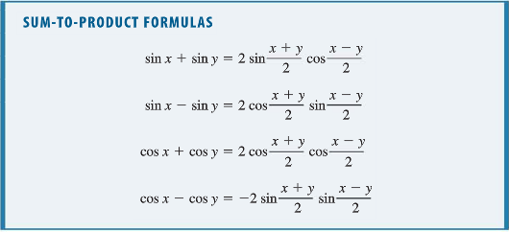
Product to Sum Formulas and Sum to Product Formulas

Slide 10
Example 5: Expressing a Trig Sum as a Product
Write sin 7x + sin 3x as a product

Slide 11
Try this one!!

Slide 12
HW #23
Read section 7.3
Section 7.3 (pg. ) #3, 4, 17, 55, 57, 61, 78
Solutions Online.

