Slide 1
Honors Precalculus: Do Now
1.) Determine the center and radius of the following circle.
x² + y² – 10x + 4y +12 = 0
2.) CHECK #6 ON YOUR HOMEWORK WITH A PARTNER.
All done? Try setting up this problem below (it’s like #6)
Find the intersection points of the following circle and line.
(x – 3)² + (y + 7)² = 25 and 4x + y = 13. i.e. solve the system.
Solutions to #53/56 on parabolas are online and all of HW #3/4

Slide 2
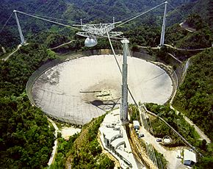
Image of the Day
The Largest Satellite Dish in the World!

Slide 3
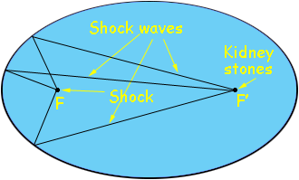
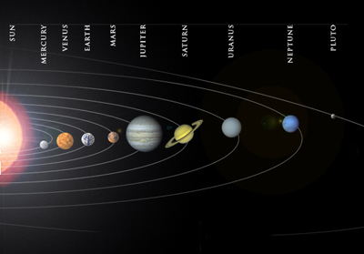
Reflective Properties of the Ellipse
http://science.howstuffworks.com/29276-100-greatest-discoveries-elliptical-orbits-video.htm

Slide 4
Ellipse
The set of all points in the plane the sum of whose distances from two fixed points F₁ and F₂ is a constant. These two points are the foci. The midpoint of F₁ and F₂ is the center.

Slide 5
Equation of an Ellipse
Foci on the x-axis
Foci on the y-axis
a>b>0
a>b>0
Vertices (a, 0) and (-a, 0)
Foci (c, 0) and (-c, 0): c² = a² – b²
Length of major axis: Horizontal: length = 2a
Length of minor axis: vertical: length = 2b
Vertices (0, a) and (0, -a)
Foci (0, c) and (0, -c): c² = a² – b²
Length of major axis: vertical: length = 2a
Length of minor axis: horizontal: length = 2b

Slide 6
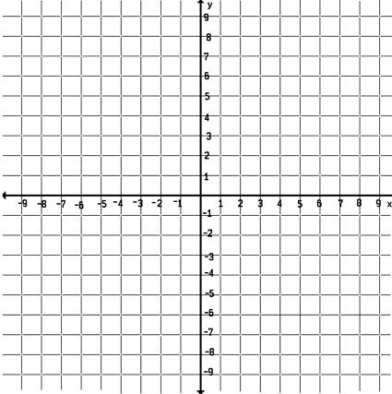
Example 1: Sketching an Ellipse
An ellipse has the equation:
a.) Find the foci, vertices, and the lengths of the major and minor axis, and sketch the graph.

Slide 7
Example 2: Finding the Foci of an Ellipse
Find the foci and vertices of the ellipse
16x² + 9y² = 144 and sketch it’s graph.

Slide 8
Example 3: Finding the equation of an Ellipse
The vertices of an ellipse are (4, 0) and (-4, 0) and the foci are (2, 0) and (-2, 0). Find its equation and sketch the graph.

Slide 9
Shifted Ellipses
General Equation for an Ellipse
Where (h, k)is the center of the ellipse.

Slide 10
Example 4: Shifted Ellipses
Sketch the graph of the ellipse:

Slide 11
Example 5:
Write the equation of the ellipse in its standard form. Find the foci and vertices of the ellipse.
4x² + 25y² – 24x + 250y + 561 = 0

Slide 12
Example 6: Writing the Equation of an Ellipse
The center is at the origin, Vertex is at (9,0) and the minor axis has a length of 4 units long.

Slide 13
Finish HW #3/4 tonight!
Worth 20 points. Do the problems on a back page on a separate sheet so that you have room.
Back Page: Part 3- Ellipses
1) a, c, e, 2.) and 3.)
We will learn about #4 tomorrow.

Slide 14
Eccentricity of an Ellipse
Eccentricity measures the deviation of an ellipse being circular by the ratio of a and c.
Where
Eccentricity is always between 0 and 1.

Slide 15
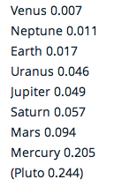
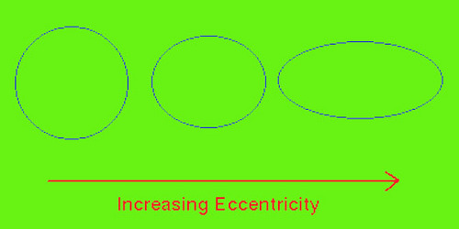
Examples of Eccentricity:
e=0.1 e = 0.5 e=0.68 e=0.86

Slide 16
Example 7: Finding the equation of an ellipse from its Eccentricity and Foci
Find an equation of an ellipse with foci (0, +/-8) and eccentricity e=4/5

