Slide 1
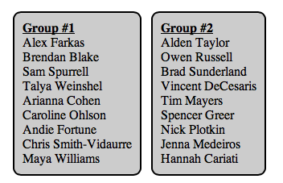
Experiment: Does Mozart help you do simple math better than techno?
Find your name on the board. Go to my website (on your phone or computer) and click on AP Statistics-then the experiment tab. If you are in group 1, click on the link that says Group 1, if Group 2, click on the link that says Group 2. Get passed the ads and pause the song when you are there. Turn your volume to 50% (this is mandatory).
We will be doing a “1 minute math test” in just a few minutes (no calculators allowed). You will be listening to a particular song depending on what group you are in and completing as many problems as you can in any order.
Mozart
Techno

Slide 2
1 Minute to Complete as Many Problems as you can.
BEGIN!
Work in any order you please!

Slide 3
Hand in your papers
Hand in your papers and I will hand them back out. You will grade someone else’s paper. Simply mark if they got the question right or wrong. Tally up how many answers they got correct and write it at the top of the page! Then pass the paper back in.

Slide 4
Testing for Significance: Difference of Means
Enter Mozart Data (group 1) into L1,
Enter techno data (group 2) into L2
STAT TESTS: 2 Sample T-Test
Data: L1, L2
Freq: 1 for both
> μ2
You could also do this for proportions if we had proportions as our data. 2 Prop – Z Test

Slide 5
Problems with the Experiment?

Slide 6
Blocking and Matched Pairs
We can BLOCK to control for the variables we KNOW ABOUT… and RANDOMIZE to control for the one’s we don’t.
Block Design: Do a completely randomized experiment with each block (i.e. gender, or age, or IQ).
Matched Pairs: before and after measurements on the SAME subjects OR PAIR the subjects in terms of features (height, age, gender, race, etc).

Slide 7
Cautions about Experimentation and Generalization
Double Blind Experiment: neither the subjects nor the researchers know which “treatment” the subject is receiving.
Sometimes it is essentially impossible to do this.

Slide 8
Reminder: Unit 5 Test
Monday: Drop (12/2)
Tuesday: Review (12/3)
Wednesday: Test on Chapter 5 (12/4)
Monday (12/9): Project 3 Due

Slide 9
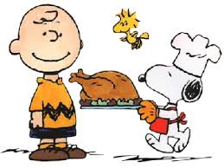
Holiday Music Problem Set
This is your review HW for the Test. It will be due on Wednesday along with the other homework assigned so far.
Work with your group to complete this!! Enjoy the music!!
HAVE A GREAT THANKSGIVING BREAK!!!

