Slide 1
AP STATS: Do Now
With your group. Read over the experimental design task and take 8-10 minutes to come up with a plan for conducting your study.
Be sure to address the questions on your sheet and be ready to present your research design to the class.

Slide 2
CDC INFO: From their website
How does CDC present data on flu vaccine effectiveness?
CDC typically presents vaccine effectiveness (VE) as a single point estimate: for example, 60%. This point estimate represents the reduction in risk provided by the flu vaccine. CDC vaccine effectiveness studies commonly measure laboratory confirmed flu illness that results in a doctor’s visit or urgent care visit as an outcome. For this outcome, a VE point estimate of 60% means that the flu vaccine reduces a person’s risk of developing flu illness that results in a visit to the doctor’s office or urgent care provider by 60%.
In addition to the VE point estimate, CDC also provides a “confidence interval” (CI) for this point estimate, for example, 60% (95% CI: 50%-70%). The confidence interval provides a lower boundary for the VE estimate (e.g., 50%) as well as an upper boundary (e.g., 70%). One way to interpret a 95% confidence interval is that if CDC were to repeat this study 100 times, 95 times out of 100, the VE point estimate would fall within the confidence interval (i.e., on or between 50% and 70%). There is still the possibility that five times out of 100 (a 5% chance) that CDC’s point estimate of VE could fall outside of the 50%-70% confidence interval.

Slide 3


Video of the Day: Conservation Task
Developmental Psychology
http://www.youtube.com/watch?v=YtLEWVu815o&safe=active

Slide 4
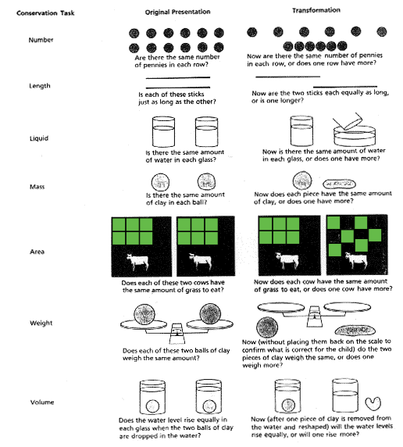
The seven tasks are not acquired at once. instead, they are acquired in the order listed here, with conservation of number typically mastered by 5 or 6, but conservation of volume often not mastered until 9 or 10. This was something of an embarrassment for Piaget, who invoked the notion of decalage ('uncoupling') in an attempt to explain why such structurally similar concepts should be acquired at such diverse ages.

Slide 5
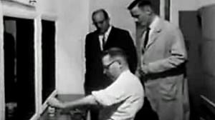
Milgram’s Famous Experiment
http://www.youtube.com/watch?v=y6GxIuljT3w&safe=active

Slide 6
Experimental Design Terminology
Experimental Study: Impose a “treatment” on the Experimental Units (subjects) and measure the response.
Experiments are designed to determine causation. Hold everything else constant and only influence the explanatory variable (factors) in different levels in order to measure the response variable.
By randomly assigning subjects to groups we can help to diminish the individual differences among participants. The more subjects the more likely the groups are to be similar. We are trying to eliminate lurking variables and systematic difference btw groups!!

Slide 7
Example: Advertising
What are the effects of repeated exposure to advertising?
Subjects all watched a 40 minute TV program that included ads for a digital camera. Some saw a 30 second commercial, others saw a 90 second commercial. The same commercial was either shown 1, 3, or 5 times.
2 Factors: length of commercial (2 levels) and and repetitions (3 levels).
6 total treatments.
**SIDENOTE: More treatments,? More subjects needed…

Slide 8
Control/ Control Group
Sometimes we only impose 1 treatment and compare it to a control group (a group that receives the all the same things but might receive the “placebo” – a dummy treatment- instead of the actual vaccine for example).
The purpose of control is to minimize variability in the way the units were obtained and treated. It allows us to eliminate “lurking variables”.
PLACEBO EFFECT: Many patients respond favorably to ANY TREATMENT, even a placebo. This may be due to trust in doctors etc.
Medical example… vaccine

Slide 9
Replication and Randomization
REPLICATION: Use enough subjects to reduce chance variation (i.e. putting all the “smart” or healthy subjects in the same group).
RANDOMIZATION: We can’t eliminate the variation, but random assignment to experimental groups helps to isolate the effects that the explanatory variable is having on the response variable.
We want to be relatively certain that the systematic differences between the groups were CAUSED by the explanatory variable and not some lurking variable.

Slide 10
Example: Does Aspirin/Beta Carotene help prevent Heart Attacks and cancer?
Subjects: 21,996 male physicians
Two Factors with 2 levels: Beta Carotene (yes or no) and Aspirin (yes or no)
Random Assignment: Randomly assigned to 4 groups to eliminate systematic differences between the groups.

Slide 11
Key Principles of Experimental Design
Control the effects of lurking variables on the response, by comparing 2 or more treatments.
Replicate each treatment on MANY units (subjects) to reduce chance variation in the results.
Randomize – use impersonal chance to assign subjects to treatments.

Slide 12
How do we know if the effects are significant?
We hope to see a difference in RESPONSES so large that is unlikely to have happened just because of chance variation.
If the differences are SO LARGE that it is unlikely that it is unlikely that it happened because of chance, than we say that the results are statistically significant.
(p-value=0.001) – we will be discussing how to calculate these values in the second semester.

Slide 13

Experiment Tomorrow
Bring headphones and your smartphone or computer to class tomorrow (as long as you have internet, you will be fine).

Slide 14
Test on Chapter 5 and Project #3
Monday (12/2)
Tuesday – Review (12/3)
Wednesday 12/4 – Test on Chapter 5
Project #3: Design an Experiment (Due Monday 12/9)
Design an experiment and write a detailed method that explains how you will go about collecting your data.
You won’t collect any data, but this can be a project that you will ultimately do as part of an end of year project. Therefore, a well-written method will be very valuable.

Slide 15
Cumulative Test:
Results Breakdown
Raw: | Scaled: | Grade:
80-100 | 5 | 90-100
67-79 | 4 | 80-90
55-66 | 3 | 70-80
45-54 | 2 | 60-70
0-44 | 1 | 0-59
Mean Raw Score: 83.11
Raw Score Standard deviation: 10.97
Mean Scaled Score: 90.875
Std. Deviation: 6.54
Mean AP Score: 4.5
Std. Deviation: 0.9

Slide 16
Test Tips: Free Response Questions
Directions: Show all your work. Indicate clearly the methods you use, because you will be scored on the correctness of your methods as well as on the accuracy and completeness of your results and explanations.
Essentially correct, partially correct, incorrect
ALWAYS include context to a problem (i.e. “Mary had a low score (82) given her unusually long paper (45 pages)”). Don’t say x and y (they have specific meaning in problems!!
Remember that the grader is grading LOTS of exams. Be explicit in your answers!!
“Mary received a grade of an 82 on her test.
We would predict that she would receive a grade of a 96.28 if she had handed it in on time.”
**Show the “plugging-in” when evaluating the predicted grade based on the regression!!
Don’t say that it would “hurt” the regression. The regression does NOT feel PAIN!!

Slide 17
Exam Breakdown (1/3 receive college credit)
Year 5 4 3 2 1 Mean
2012[31] 12.6% 20.2% 25.0% 18.8% 23.4% 2.81
2013[32] 12.2% 20.9% 25.7% 18.1% 23.1% 2.80

Slide 18
HOMEWORK 32
Section 5.2
Exercises #: 5.35, 5.36, 5.39, 5.40

