Slide 1
Honors Precalculus: Do Now
Solve for x.
4^{2x – 1} = 3^{x – 3}
You deposit $7550 in an account that pays 7.25% interest compounded continuously. How long will it take the money to triple?

Slide 2
Honors Precalculus: 50pt Quiz
Take 20-25 minutes to complete your quiz.
I will ONLY grade BOXED FINAL ANSWERS (be neat).
Show all work. No work, no credit. Even though only the final answer will count. If you don’t show work, you won’t get credit.

Slide 3
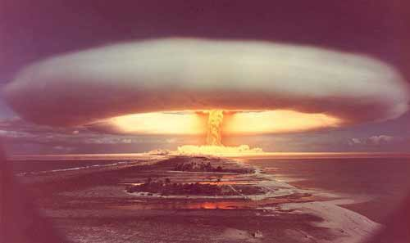
Video of the Day
Atomic Bomb Explosion This is what exponential growth looks like. Only 1.5 lbs of Uranium underwent nuclear fission.

Slide 4
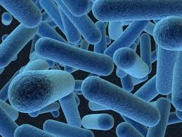
Exponential Growth
Under ideal conditions a certain population of bacteria doubles in size every 3 hours. If the culture started with 1000 bacteria. Write a function for the number of bacteria after t hours.

Slide 5
Population Size
A population that experiences exponential growth increases according to the model
n(t) = n₀e^{rt}
r is relative growth rate of the population expressed as a proportion of the population AT ANY TIME.

Slide 6
Example 1:
The initial bacterium count of a culture is 500. a Biologist later makes a sample count of bacteria in the culture and finds that the relative rate of growth is 40% per hour.
A.) write the function that modes the number of bacteria after t hours
B.) what is the estimated count after 10 hours.
C.) sketch a graph of the function.

Slide 7
Example 2: Rabbit Population
A certain breed of rabbit was introduced onto a small island about 8 years ago. The current rabbit population on the island is estimated to be 4100, with a relative growth rate of 55% per year.
a.) what was the initial size of the population.
b.) estimate the size of the population 12 years from now.

Slide 8
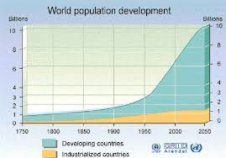
Example 3: World Population
The population of the world in 2000 was 6.1 billion people with a relative growth rate was 1.4% per year. If the population continues to grow at this rate, when will it reach 10 billion people (according to this model). What if the relative growth rate was instead 1%?

Slide 9
Example 4: World Population
The population of the world in 2000 was 6.1 billion people and the current population in 2013 is 7.2 billion people. Use this info to determine the ACTUAL relative growth rate during that time period.

Slide 10
Example 5: Bacteria Growth
The initial size of a culture of bacteria is 1000. After one hour the the bacteria count is 8000.
a.) Find a function that models the the population after t hours.
b.) Find the population after 1.5 hours
c.) When will the population reach 15,000

Slide 11
Radioactive Decay!! Half-Life Derived
FUNCTION: m(t) = m₀e^{-rt} or m(t)=m₀2^{-t/h}
Half Life (h): Time for half of the mass to decay.

Slide 12
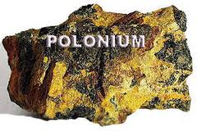
Example 6: Radioactive Decay!
Polonium-210 (²¹⁰Po) has a half life of 140 days. Suppose a sample of this substance has a mass of 300 mg.
a.) Find a function that models the amount of the sample remaining at time t.
b.) Find the mass remaining after one year.
c.) How long will it take for the sample to decay to a mass of 200 mg?
d.) Sketch a quick graph.

Slide 13
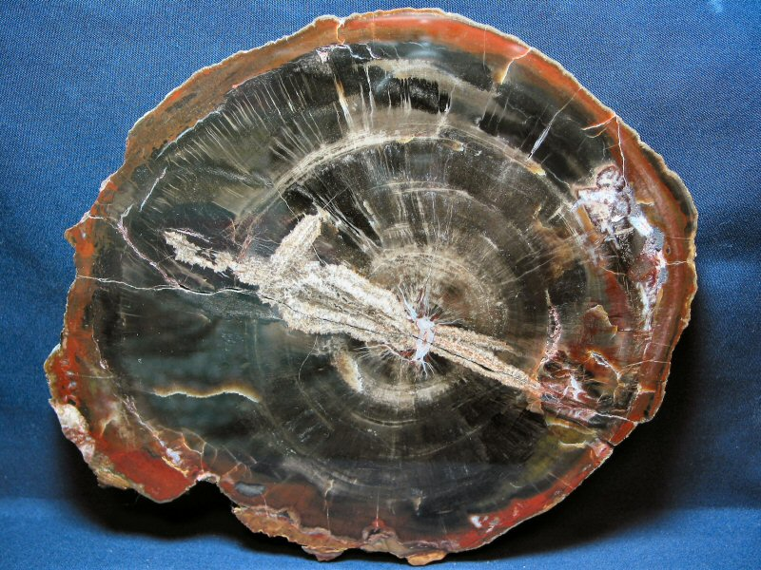
Example 7: Carbon Dating
Carbon-14 is one of the most common methods used to date ancient materials (as it has a half life of about 5730 years). Suppose that an ancient tree is found that has 30% Carbon-14 compared to the living sample. How old is the piece of wood?

Slide 14
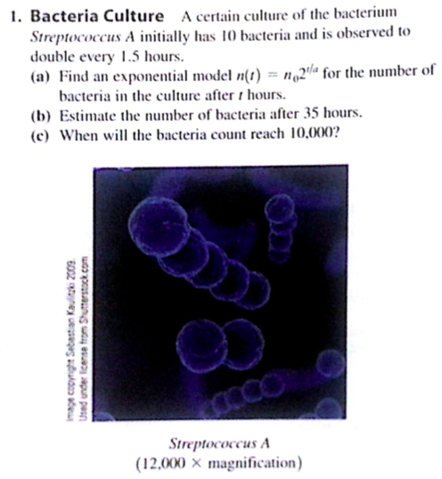
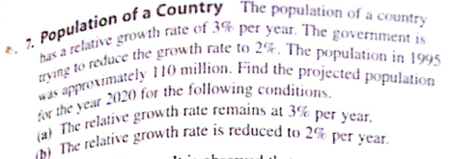
Homework #42
Read section 4.6 (through example 6)
Pg. 379-380 #1, 3, 7, 9, 13, 15, 17, 19

Slide 15
