Slide 1
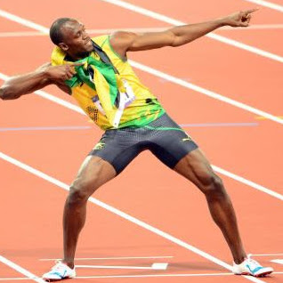
Honors Precalcus: Do Now Below are the split times for Usain Bolt’s Record Breaking 100 meter race.
Calculate his average rate of change (speed) between 0-50M?
Calculate his average rate of change (speed) between 50-100M?
Calculate his average rate of change (speed) between 50-60M?
Time (sec.) | Distance
0 s | 0m
1.85 s | 10m
2.89 s | 20m
3.78 s | 30m
4.64 s | 40m
5.49 s | 50m
6.31 s | 60m
7.11 s | 70m
7.92 s | 80m
8.74 s | 90m
9.58 s | 100m

Slide 2
Video of the Day!

Slide 3
Homework Questions???
Recall that the test will be:
Tuesday for period 1 and 2
Monday for Period 3.

Slide 4
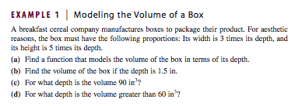
Example 1: Function Modeling

Slide 5
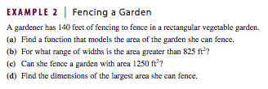
Example 2: Function Modeling

Slide 6
Example 3: Function Modeling

Slide 7
HW #10: Function Modeling
Function Modeling Section:
Pg. 218-222 #1, 5, 10, 14, 26, 29

