Slide 1
Honors Precalc: Warm Up
You get offered a job with a salary of $45,000 out of college and are guaranteed a raise of $1,400 after each year. Find your total earnings over 10 years.

Slide 2
Agenda/Video

Slide 3
Geometric Series
Remember… an arithmetic sequence is generated when we repeatedly add a number d to an initial term a.
A geometric sequence is generated when we start with a number a and repeatedly multiply a fixed constant r.
SUCCESIVE TERMS HAVE A CONSTANT RATIO!!
Takes the form:
a, ar, ar², ar³, ar⁴, …
Nth term: a_{n} = ar^{n-1}

Slide 4
Some Examples

Slide 5
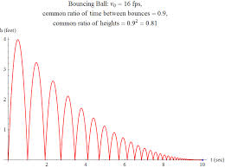
Example 1: Bouncing Ball
A bouncy ball has elasticity such that when it is dropped, it bounces up 1/3 of the distance it has fallen. If the ball is dropped from a height of 2 meters. Find the height of the ball after its nth bounce.

Slide 6
Example 2: Terms of a Geometric Sequence
Find the eighth term of the geometric sequence.
5, 15, 45,…

Slide 7
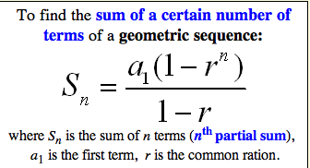
Partial Sums of Geom. Sequence

Slide 8
Example 3: Find the Partial Sum
Find the sum of the first five terms of the geometric sequence:
1, 0.7, 0.49, 0.343,….

Slide 9
Example 4: Find the Partial Sum
Find the sum

Slide 10
Converging/Diverging
Infinite series can converge or diverge.

Slide 11
Example 5: Infinite Series
Determine whether the infinite geometric series is convergent or divergent. If it is convergent, then find its sum.

Slide 12
You Try!

Slide 13
HW/Practice Problems

