Slide 1
Honors Precalc: Do Now
Choose #1 or #2
1.) The AUDI A4 has a lifespan of that is normally distributed with a mean of 7.5 years and a standard deviation(σ) of 1.3 years. What is the probability that your AUDI will break down during the car’s guarantee period of 6 years or less?
2.) The SAT Verbal in the country is normally distributed and has a mean of 490 and a standard deviation of 94. If you scored a 600 on the SAT VERBAL, what percentile are you in?
b.) If one of your friends scored a 600 and the other scored a 760, what percent of test takers scored between those two scores?

Slide 2
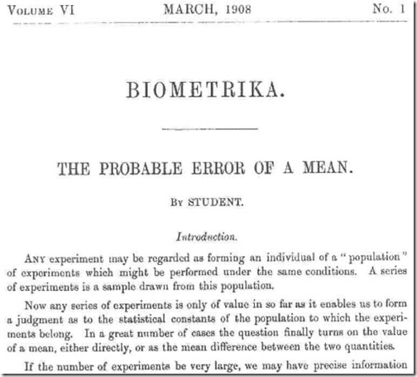
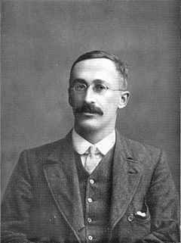
Who is STUDENT anyways?
Student’s t-distribution (William Sealy Gosset).
When Gosset joined Guinness, Dublin, his task was to perfect the process of brewing beer.(5) The principle was that one had to add an exact amount of yeast colonies to a certain amount of fermenting barley to turn it into beer. Too few colonies and the brew would be incompletely fermented and too much, it would become bitter.
Gosset was taking small samples and trying to extrapolate his findings to large populations. Before Gosset it was thought that you needed a large sample to determine population parameters. Gosset discovered that you could STILL determine population parameters with a certain amount of certainty using SMALL samples.

Slide 3
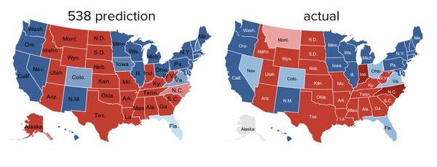
Picture of the day! Nate Silver
The real winner wasn’t Silver, but the math. The 2012 election was a real-time experiment in the accuracy of statistical modeling, and it passed with flying colors. That doesn’t mean there still isn’t room for improvement, or that such models are infallible, but the fundamental principles are solid. For now. Call it the triumph of the nerds. I doubt we’ve seen the end of denialism, by a long shot, but it’s nice when, once in awhile, scientific rigor gets a big win.

Slide 4
Nate Silver
TRUST MATH NOT INSTINCTS.

Slide 5
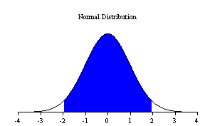
Confidence Intervals
A confidence interval allows us to predict the interval that the TRUE population mean (μ) could take on with a certain level of certainty given the mean of a sample.
In other words, it is a test for the reliability of an ESTIMATE.
GENERAL IDEA:
ESTIMATE plus or minus the Margin of Error.
We can do this for a proportion or for a mean. We will do both today.

Slide 6
Confidence Interval When the Population Std. Deviation is known
THIS IS RARE TO KNOW THE POPULATION STANDARD DEVIATION.
Critical z-values:
90% Confidence: z = 1.645
95% Confidence: z = 1.96
99% Confidence: z = 2.576

Slide 7
Example 1:
Mr. Young wants to find the average height of Moses Brown HS students. To do so Mr. Young takes a simple random sample of 25 students and measures their height. The average height of these 25 students is x = 68.3 inches. The heights of the students at Moses Brown is normally distributed with a standard deviation (of the population) of σ = 2.35 inches.
a.) Find a 95% confidence interval for the average height (μ) of Moses Brown HS students?
b.) Interpret Your Results:___________________________________
_________________________________________________________

Slide 8
Confidence Interval When the Population Std. Deviation is NOT KNOWN!!
THIS IS MUCH MORE COMMON AND WE THEN USE A T-TEST (which is basically
a set of normal curves and depends on the number of people sampled (called the
degrees of freedom).
Where t is the critical value with n-1 degrees of freedom.

Slide 10
Example 2: Don’t know the population std. deviation.
Anton is studying how long it takes him to get to school everyday. He tracks how many minutes it takes him to get to school for 30 days. He finds that the mean (x) was 24.8 minutes and the standard deviation (s) was 2.9 minutes. Let μ be the mean time it takes Anton to get to school for the entire distribution. Find a 0.99 confidence interval for μ.
INTERPRETATION:___________________________________________
__________________________________________________________

Slide 11
Confidence Intervals for Proportions
Critical z-values:
90% Confidence: z = 1.645
95% Confidence: z = 1.96
99% Confidence: z = 2.576

Slide 12
Example 3: Collecting Real Data
Option A: Calculate the percent of the globe that is covered by water!
Option B: ROLL A DICE 25 times. Count the number of times that it lands on the number 2. Construct a 95% confidence interval for the percent chance that a die will land on the number 6 when rolled.

Slide 13
Example 4: Polling
A polling company took a simple random sample of 1000 voters in Rhode Island before the election to determine who they were going to vote for for president. 61.3% of voters said Obama. Conduct a 95% confidence interval for the true percent of voters in Rhode Island who are planning on voting for Obama.

Slide 14
Homework!!
HOMEWORK #33- Work with people around you to answer the following questions.

