Slide 1
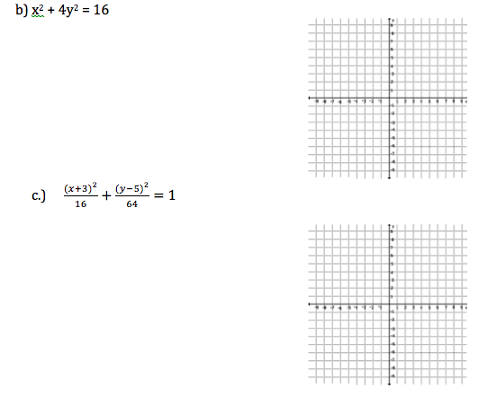
Honors Precalculus: Do Now
The following is a review packet for the Unit Test which will be on Thursday, Feb 13th. It is also your HW until the unit test (worth 40 points). For your warm-up, complete Ellipses (on page 6) 1b and 1c. We will have a full class day to work on this as well.

Slide 2
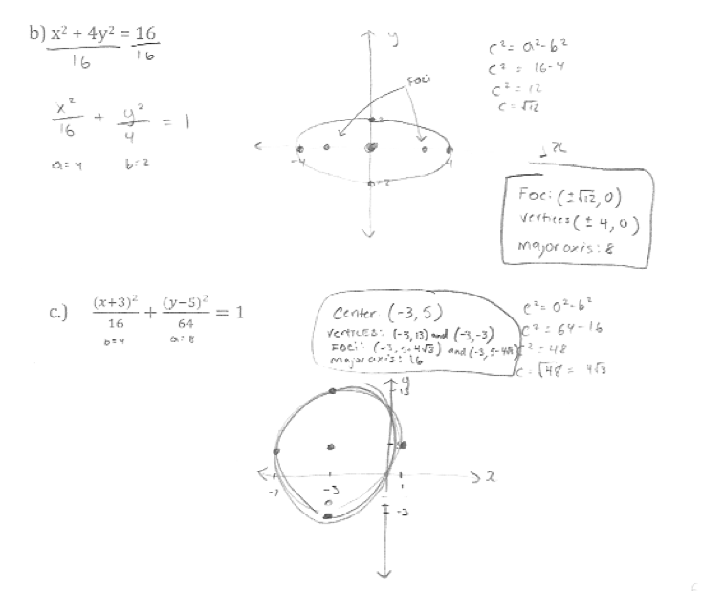

Slide 3

Video of the Day!
Earth’s Motion Around the Sun
http://www.youtube.com/watch?v=82p-DYgGFjI
UNIT TEST:
Thursday: Feb 13th

Slide 4
Eccentricity of an Ellipse
Eccentricity measures the deviation of an ellipse being circular by the ratio of a and c.
Eccentricity is always between 0 and 1 for an ellipse.

Slide 5
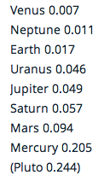
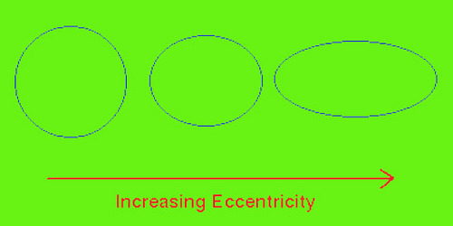
Examples of Eccentricity:
e=0.1 e = 0.5 e=0.68 e=0.86
http://www.mathsisfun.com/geometry/eccentricity.html

Slide 6
Example 1: Finding the equation of an ellipse from its Eccentricity and Foci
Find an equation of an ellipse with foci (0, +/-8) and eccentricity e=4/5

Slide 7
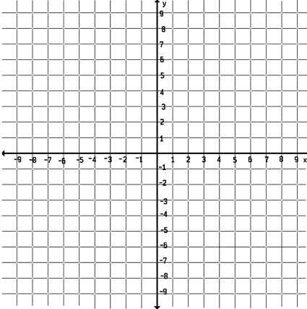
Hyperbola!
A hyperbola is the set of points in a plane the difference of whose distances from two fixed points F₁ and F₂ is a constant. These two fixed points are the foci of the hyperbola.

Slide 8
Example 1: Graph the hyperbola
A hyperbola has the equation 9x² – 16y² = 144. Find the vertices, foci, and asymptotes. Sketch the graph.

Slide 9
Example 2: Graph the hyperbola
A hyperbola has the equation x² – 9y² + 9 = 0. Find the vertices, foci, and asymptotes. Sketch the graph.

Slide 10
Example 3: Graph the shifted hyperbola
A hyperbola has the equation 9x² – 72x -16y² – 32y = 16. Find the center, vertices, foci, and asymptotes. Sketch the graph.

Slide 11
PROBLEM SET
The following PS will be due on Wednesday (the day of your test). It is great practice for test-like problems. The solutions will be posted online and I will count it as 3 HW’s (a full week of HW).
Take the rest of the period to work on the Problem Set in Teams. We will be looking at Hyperbolas tomorrow.

Slide 12
Honors Precalculus Do Now
Find an equation of an ellipse with foci (0, 3) and (0, -3) and eccentricity e=9/10. Sketch a brief graph.
Find the intersection between the following ellipse and line algebraically. And -2x + y = 5. Try
graphing them on your calc to check the solution.

Slide 13
Video of the Day
Using gravity to slingshot a rocket

