Slide 1
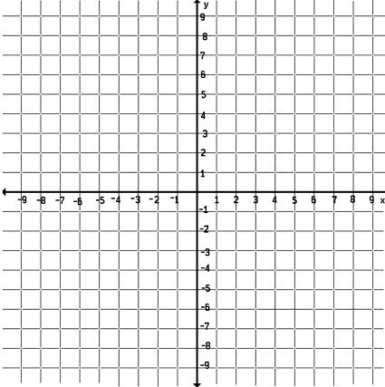
Honors Precalculus: Do Now
The Big Kahuna!
1.)Graph the following hyperbola. Find the Center, vertices, foci, and asymptotes. Hint Hint…. Put it in standard form by Completing the SQUARE!!
−9x² + 25y² − 100y − 125 = 0

Slide 2
Video of the Day
Whispering Gallery

Slide 3
Example 1: Finding the Intersection
Find the intersection between the following ellipse and line algebraically. And -2x + y = 5.
Try graphing them on your calc. to check the solution when done.

Slide 4
Example 2: Solving a System of Conics
3x² + 2y² = 35 4x² – 3y² = 24

Slide 5
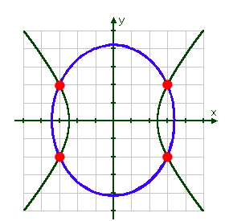
Graph of Problem

Slide 6
General Equation of a Conic Section
The general equation of a conic section is:
Ax² + Cy² + Dx + Ey + F = 0
Where A and C are BOTH not zero.
1.) A parabola when A OR C is zero.
2.) An Ellipse if A and C have the same sign
3.) A Circle if A = C
4.) A Hyperbola is A and C have opposite signs.

Slide 7
Example 3: Classify each conic section and write its equation in standard form.

Slide 8
PROBLEM SET
The Conic Sections PS (handed out already) will be due on Thursday (the day of your test). It is great practice for test-like problems. The solutions are posted online and it will count it as 4 HW’s (a full week of HW).
Take the rest of the period to continue working on the Problem Set in Teams. Start with Mixed Parabolas.

