Slide 1
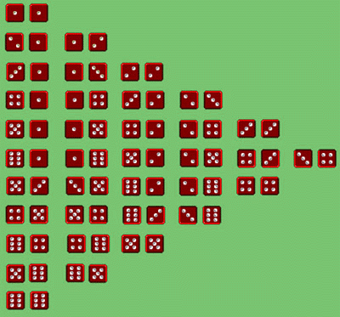
Honors Precalculus: Do Now
1.) A game consists of rolling a die. You receive the face value in dollars if an odd number is rolled. If the game costs $1.50 to play (which you do not get back, regardless of what is rolled), what is the expected value to you?
2.) A sales clerk works for commission only. If 20% of the customers purchase an item for which the clerk gets a $3 commission, 10% purchase an item for which the clerk gets a $5 commission, and 5% purchase an item for which the clerk gets an $8 commission, what is the expected value per customer who enters the store?
3.) You roll two dice. What is the expected value of the sum?

Slide 2
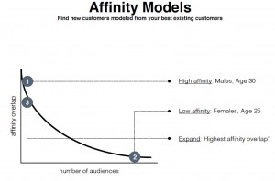
Idea of the Day
Stats from Nanigans, a Facebook advertising company.

Slide 3
Any thoughts/questions regarding the Hedge Fund Article
What stood out for you?

Slide 4
Example 1: Fundamental Counting Principal
Baskin-Robbins offers 3 types of cones and 31 flavors. How many different single scoop cones are possible at the store? Double scoops?

Slide 5
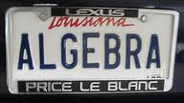
You Try: License Plates
In a certain state, auto license plates display 3 letters followed by three digits. How many such plates are possible if repetition:
a.) is allowed b.) Not allowed

Slide 6
Factorials
5! =

Slide 7
Permutations/Combinations
Permutations: Order Matters
Combinations: Order does NOT matter

Slide 8
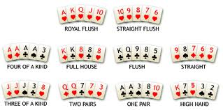
Example 1:
a.) You are playing poker with a 52 card deck. How many different 5 card hands are possible?
b.) From 20 raffle tickets in a hat, four tickets are to be chosen at random. The holders get a free trip to the Bahamas. In how many ways can the 4 winners be chosen?

Slide 9
Example 2:
a.) How many different ways are there to arrange the letters in my last name YOUNG
b.) A club has 9 members. In how many ways can a president, vice president, and secretary be chosen from the members of this club?
How about different ways to arrange the letters in the word APPLE?

Slide 10
Example 3:
A committee of seven- consisting of a chairman, a vice-chairman, a secretary and four other members – is to be chosen from a class of 20 students. In how many ways can the committee be chosen?

Slide 11
Example 4: Tricky…
The cast of Ocean’s 11 is posing for a picture. How many ways can they line up if:
a.) Brad Pitt and George Clooney insist on standing next to each other
b.) Matt Damon and Casey Affleck refuse to stand next to each other

Slide 12
YOU TRY! Combination Lock
A combination lock has 40 different positions (0-39). To open the lock, the dial is turned to a certain number in the clockwise direction, then to a number in the counter clockwise direction, and finally to a third number in the clockwise direction. If successive numbers cannot be the same, how many different combinations are possible.

Slide 13
You Try!! The Lottery
Calculate the probability of winning the Powerball jackpot. You pick 5 numbers between 1-59 (white ball- no repetitions) and you must match the Powerball (red ball- between 1-35). Order doesn’t matter for the white balls.
What is the expected value of a ticket if the ticket costs $1 and the jackpot is now at 130 million dollars?

Slide 14
HW #30
Complete the HW worksheet!

