Slide 1
Honors Precalculus
Take a look at your Unit Test. We will go over a few problems as a class in a bit.
Some statistical summaries from the first test.
Mean: 88.88
Standard Deviation: 7.30
Median: 90.5

Slide 2
Homework Questions?

Slide 3
Video of the Day

Slide 4
Zeros of Polynomials
Example: P(x) = x² + x - 6

Slide 5
Graphing Polynomials by Hand

Slide 7
You Try!

Slide 8
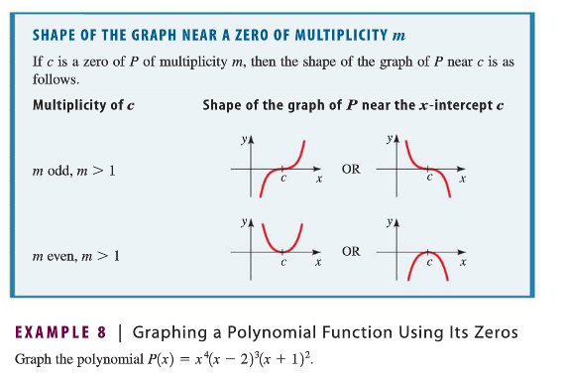
Bounces and Crosses Reminder

Slide 9
How Many Local Mins and Maxes?
A polynomial of degree n can have NO MORE THAN n – 1 local extrema.

Slide 10
HW #15: Graphing Polynomials
Section 3.2 Pages 244-245
#27, 31, 33, 59, 63, 77, 81
Need some function modeling review?
Try #83 (it’s optional though).

