Slide 1
Honors Precalculus: Warm-Up
Use the first 15-20 minutes to work at your table on the review homework or the polynomial application problems. It is also your opportunity to call me over to get some clarification on a problem.
We will spend the second half of class doing a review game: trashketball.

Slide 2
Try out this one!

Slide 4
TRASHKETBALL!!

Slide 7
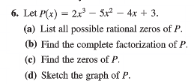

Slide 9
Complete the FAITS!

Slide 10
A challenge!

