Slide 1
Honors Precalculus: Do Now
A union spokesperson claims that 75% of union members will support a strike if their basic demands are not met. A company negotiator believes the true percentage is lower and runs a hypothesis test at a 10% significance level. What is the conclusion d 87 out of an SRS of 125 Union members say they will strike?
H₀:___________________
H₁:___________________
P = ____________________
P-hat=__________________
N=_____________________
1 PROP Z-TEST

Slide 2
Quote of the Day
“Live as if you were to die tomorrow. Learn as if you were to live forever.”
~Mahatma Gandhi

Slide 3
Remember….
We perform hypothesis tests to PROVE beyond a reasonable doubt that something is happening and it NOT simply happening by chance!
This does not mean that we are 100% confidence of something but we can prove something with a certain level of potential error that we are satisfied with.
By the way, if we can’t reject the null hypothesis, it doesn’t mean that the null hypothesis is true…. It simply means that we don’t have enough evidence to disprove the null hypothesis.

Slide 4
P-Value
If the p-value is less than the significance level (i.e. α =0.05) than we can reject the null hypothesis in favor of the alternate hypothesis.
The P-Value is actually a conditional probability. It tells us the probability of getting results at least as unusual as the observed statistic, given that the null hypothesis is true.

Slide 5
Alternate Hypothesis
P > ____
P <____
P≠____ (two tailed test)

Slide 6
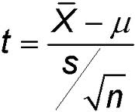
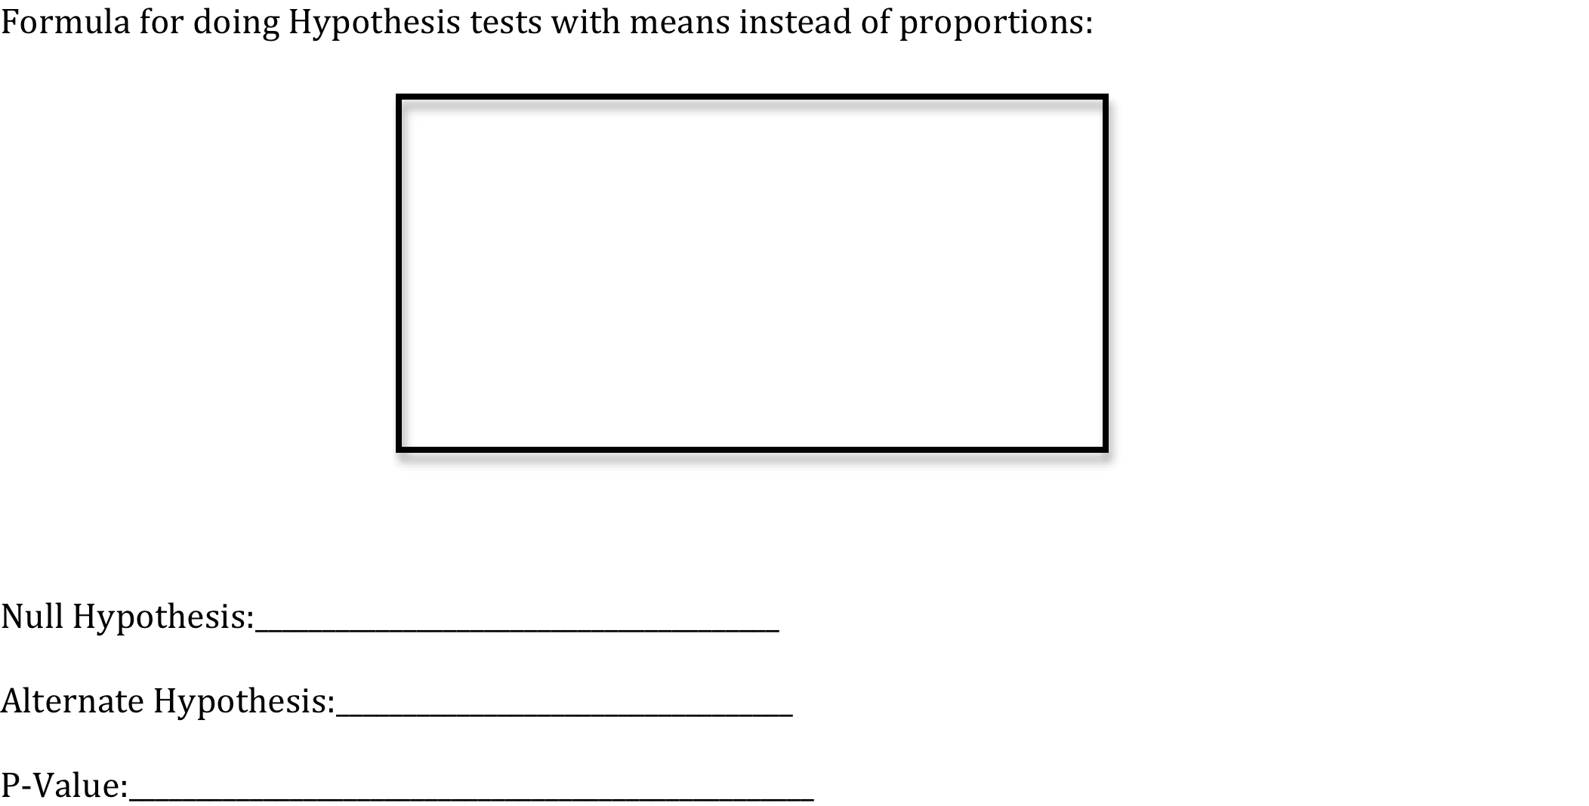
Hypothesis Testing for Means

Slide 7
Example 1: Speed Limit
The speed limit on Gano street is posted as 25 mph. I want to know whether the mean speed of vehicles exceeds the posted speed limit of 25 mph. I have a sample of 23 car speeds from yesterday and find the sample mean of the cars to be 27.5 mph with a standard deviation of 4.25 mph. Can I conclude with a significance level of α=0.05 that the mean speed exceeds 25mph?
Calc: T-test

Slide 8
Example 2: Weather
Suppose we want to show that the average temperature in Providence is increasing. The mean temperature for April in Providence is 59.5°. Suppose that a random sample of 30 days in April were used and we found that the average temperature was x = 63.2° with a standard deviation of s = 4.3°. Can we conclude that the mean temperature is increasing in Providence (use a level of significance of α = 0.05).

Slide 9
YOU TRY! Braking
A tire manufacturer is considering a newly designed tread pattern for its all weather tires. Tests have indicated that these tires will provide better gas mileage and longer tread life. The last remaining test is for braking effectiveness. The company hopes that the the tire will allow a car travelling at 60 mph to come to a complete stop within an average of 125 feet after the brakes are applied. They will adopt the new tread pattern unless there is strong evidence that the tires ARE MORE THAN this objective. The distances (in feet) for 9 stops on a test track were 129, 128, 130, 132, 135, 123, 125, 128 and 130. Should the company adopt the new tread pattern? Test an appropriate hypothesis and state your conclusion using a 0.01 level of significance.

Slide 10
HW #35
HANDED OUT.
INCLUDES BOTH PROPORTIONS AND MEANS.

