Slide 1
WARM-UP: T-Test
Start by looking at your comments on
your project.

Slide 2
Weekly Agenda
Monday: 12.2 Hypothesis Tests (proportions)
Tuesday: Review 12.2/12.3 activity
Wednesday: Review for the Chapt. 12 Test
Thursday: Ch. 12 test
Friday: Project work day

Slide 3
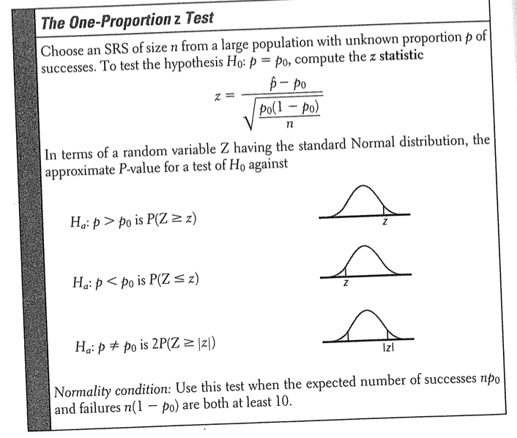
RECALL OUR ACTIVITY ABOUT CALCULATING WHAT PERCENT OF THE EARTH IS WATER

Slide 4
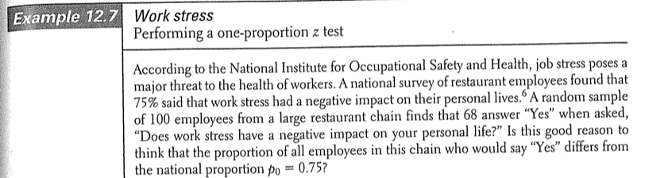
1-PROP Z-TEST

Slide 5
Results from our study…
I tabulated the results from the Coke/Pepsi and Fiji/Tap water studies. Our results are statistically significant (at a 0.01 sig level). Here are the basic findings. There was a 0.6% chance that the results we found were due to chance given that the null was true (i.e. we could not tell the difference between the products). for the Coke/Pepsi study (this is called the p-value in statistics). This suggests that on average, my AP stats class can in fact tell the difference between Coke and Pepsi. For the tap water/Fiji study the results are even more pronounced. There was only a 0.02% chance that the results we saw were due to chance, given that the null is true. This means that we can pretty conclusively say that our class could tell the difference between tap water and Fiji bottled water.

Slide 6
Confidence Intervals Provide Additional Information
A significance test can detect an effect, but it might be unclear as to how big or small that effect is.
Confidence intervals provide insight into the size of the effect by reporting an interval in which the true parameter is likely to fall.

Slide 7

Compute a 95% Confidence Interval for the Previous Problem.
What additional information does this interval give us?

Slide 8
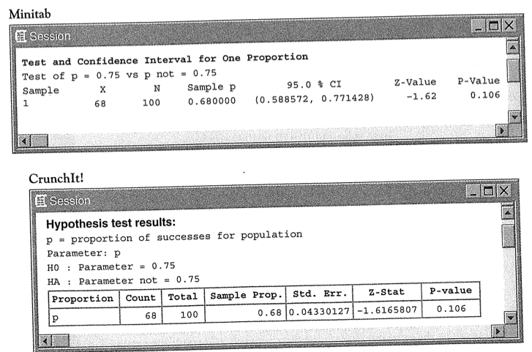
Computer Output for Results

Slide 9
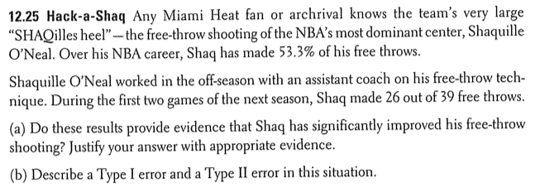
You Try!

Slide 10
HW #14: Hypothesis Tests for Proportions
Read section 12.2
12.24, 12.26

