Slide 1
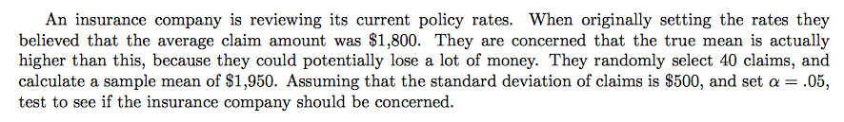
AP STATS: WARM UP
1.) Do this by hand and then use a Z-Test on your calculator so that you practice
both. State hypotheses, check conditions, calculations, interpretation.
2.) Finally, compute a 95% confidence interval.

Slide 2
A few notes:
We can’t ACCEPT the null.
We can either reject the null or fail to reject the null hypothesis.
P-Values are Conditional Probability.
Why might a one sided test be “better” for a researcher?

Slide 3
Monday 11.4 (Big Day!! Type 1 and 2 errors/Power.)
Tuesday: Review
Wednesday: Test on Ch. 11

Slide 4
11.3 Hypothesis Tests: Use and Abuse
Statistical significance is valued because it points to an effect that would be unlikely to have occurred simply by chance.
Used in pharmaceuticals/medicine, advertising campaigns, courts, marketing, etc.
Getting a P-value is easy, using tests wisely is not so simple.

Slide 5
Choosing a level of significance
How small of a p-value do I actually need to convince you?
How plausible is H₀?
What are the consequences of rejecting H₀?

Slide 6
Statistical Significance is NOT the same as Practical Importance
Sometimes you can get a statistically significant result (especially with a large sample) but it has no practical importance. Very small effects can be highly significant, especially when based with a large sample.
Be sure to examine the data. If the sample has outliers, it can make a result seem significant.
REPORT A CONFIDENCE INTERVAL. THIS GIVES THE SIZE OF THE EFFECT AS OPPOSED TO JUST A HYPOTHESIS TESTS (which is a reject or no reject situation).
EXAMPLE: EFFECTS OF ADVERTISING ON SALES.

Slide 7
Don’t Ignore LACK of Significance
Just because your results are not statistically significant does not mean that they are not valid (is p=0.049 really that different from p=0.051? Of course not!).
You might have a big effect, but a small sample makes it statistically insignificant!
Most journals place WAY TOO MUCH emphasis on the 5% level of significance and won’t publish articles unless they meet this measure.

Slide 8
Don’t forget about GIGO
Fancy formulas can’t fix bad data or data that is meaningless. Experiments must still be designed properly. Don’t be fooled by a p-value alone. Always ask HOW THE DATA WERE PRODUCED!! Was there bias (undercoverage, dropouts, response bias) in HOW the data was produced?

Slide 9
The problem with a 5% level of significance.
Let’s say you are a researcher and doing 20 tests at once. Probability tells us that you will likely see a significant result by chance alone in about 1 of 20 of those experiments.
ESP EXAMPLE AS A CLASS!
BEWARE OF MULTIPLE ANALYSES!!! You should have an effect in mind that you are looking for.
The best evidence for something are multiple experiments that show significant results and whose results are consistently replicable in a variety of different tasks/experiments.

Slide 10
Project Design: Like a watered down
College Thesis
Take the end of class to brainstorm what you want to do for your final project. You should choose an experiment or a survey and your topic should have a theme (i.e. homework, recycling, incentives, etc.). You should always collect anonymous informational statistics
Keep in mind that you will need several visuals (graphs, boxplots, etc.) as well as confidence intervals, hypothesis tests, etc. as a part of your study. Keep this in mind when you collect data.
Use a Google form NOT survey monkey to collect data (if you do a survey) . It’s free and imports your data into excel automatically.
Survey Examples:
Homework at MB
Quality of food services
Sports
Etc.
Experiment Examples
Incentives for performance
Response rates for how you word
a question.
The effect of practice on the ability
to complete a task.

Slide 11
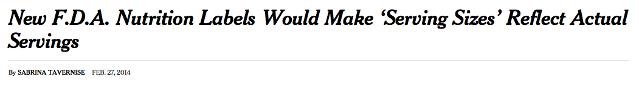
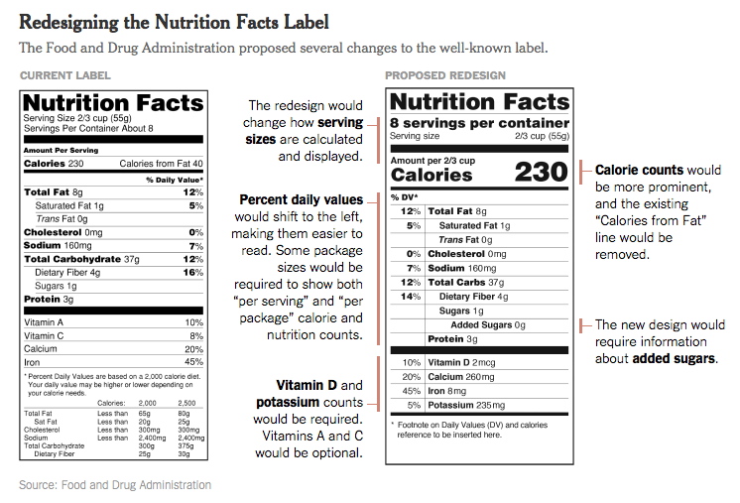

Slide 12
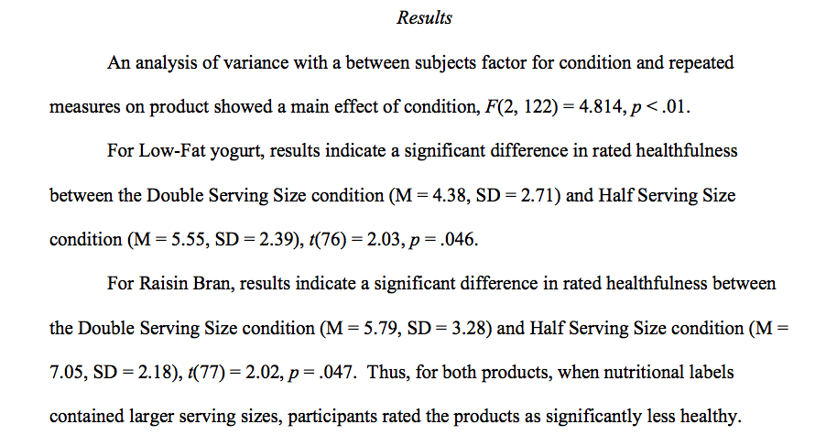
Study 2 examined how serving size affects individuals’ perceptions of the same food products as used in Study 1. In the study, depending on the condition, the serving size and corresponding nutrition facts were either doubled or cut in half for two target products. Thus, the actual contents of each product were identical in all 3 conditions; the only difference was how the product’s nutritional contents were described in terms of the serving size.

Slide 13
HW #12
Read the article handed out in class.
Read 11.3
If you didn’t pass the test. You may write a 1 page summary (double spaced) of the article, highlighting the important points of the article. This will bring your grade up to a 70.
Complete exercises 11.44, 11.45, 11.47

