Slide 1
AP STATS
What were some highlights/take-aways from going to the poster session?
What are some things that you want to do with your own poster now that you have seen others?
What made for a good poster?

Slide 2
Agenda
Wednesday – No class (juniors don’t get back until 12:30)
Use the day to work on your project if you are around.
Thursday: Test on Chi Square/Inference for Regression (HW 19-21 will NOT be checked- but… I will give you credit if you verify that day that you did in fact complete all those problems).
Monday evening – add the intro to your poster – see Amanda’s poster. You should think about getting into the computer lab and doing inference (CI’s and Hypothesis tests) if you can. We will go into the lab next week.

Slide 3
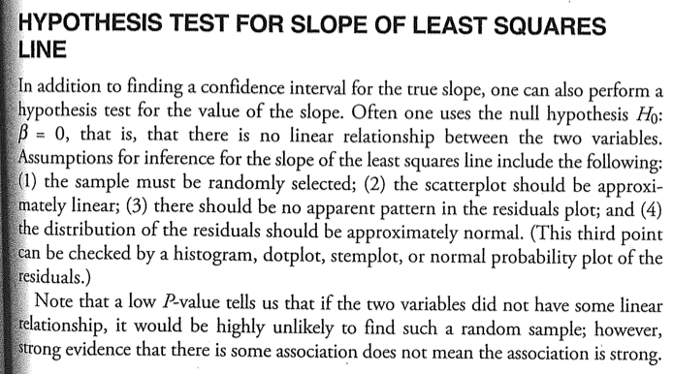

Slide 4
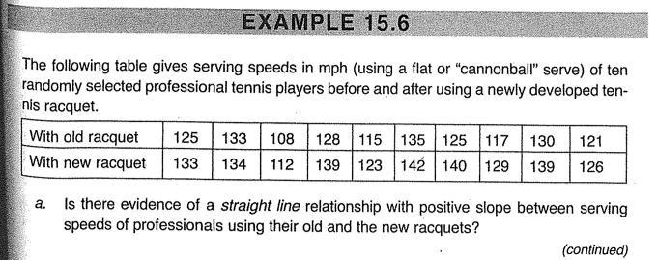
Conditions:
1. SRS
2. Scatterplot approx linear
(i.e. No pattern in residuals)
3.) Distribution of residuals is approximately normal.

Slide 5
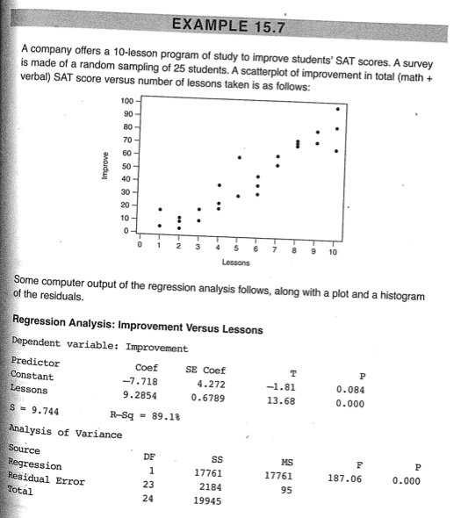
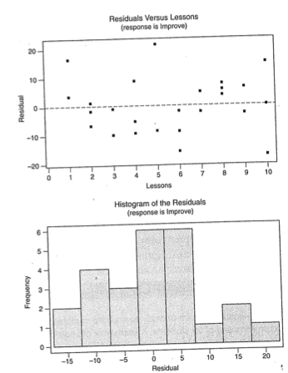

Slide 6
HW 21/Classwork
Complete MC #11/12
Complete FR #6/7

