Slide 1
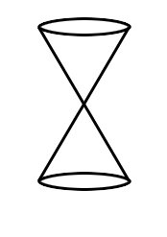
Honors Precalculus: Do Now
Take the following shape (called a double napped cone -it is hollow). Draw it on your paper. Now take a plane and intersect the double napped cone in different ways with the plane (i.e. imagine slicing it with a samurai sword).
What 2d shapes can you make by intersecting the cone with a plane (see figure at the front of the class).

Slide 2
Video of the Day!
http://www.youtube.com/watch?v=TtzRAjW6KO0

Slide 3
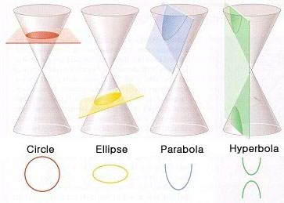
Conic Sections
Conic sections are formed when you take a straight cut out of a cone (i.e. when a plane
Intersects a cone). These are the shapes that are formed.
Our goal for this chapter is to find equations whose graphs are conic sections. We will focus on the Geometric properties of each as opposed to their purely algebraic properties.

Slide 4
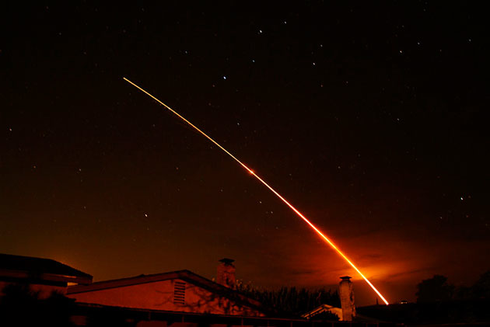
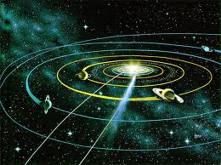
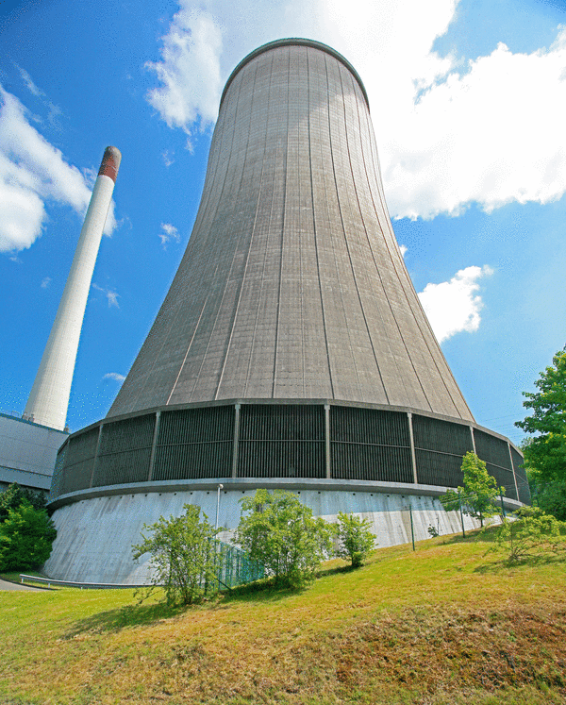
Some Typical Uses of Conic Sections
The path of a projectile (rocket, basketball, etc.)
Satellite dishes, car lights.
Planetary orbits are ellipses
The shape of a cooling tower is a hyperbola.

Slide 5
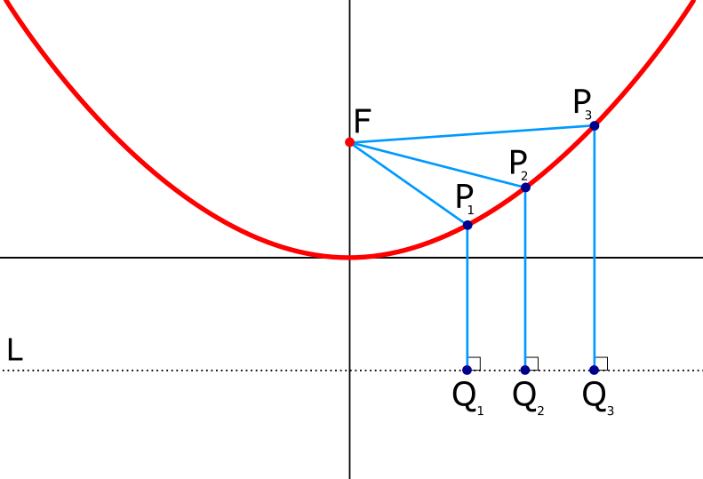
Parabola
The first conic section we will look at is the parabola (a shape that you have seen a lot of). Though this time we will focus on the shape from a geometric perspective.
Geometric definition of a parabola: The set of points in a plane that are equidistant from a fixed point F (called the FOCUS) and a fixed line l (called the DIRECTRIX).
FOCUS: (0, p)
DIRECTRIX: y = -p

Slide 6
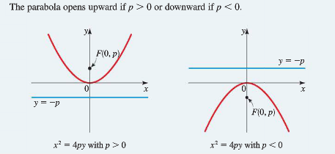
Parabola with vertical Axis
The graph of the equation (comes from the distance formula-derivation is in your book-10.1):
X² = 4py
Vertex: V(0,0)
Focus: F(0, p)
Directrix: y = -p
If p > 0 opens up.
If p < 0 it opens down.

Slide 7
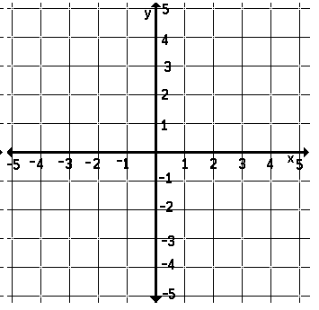
Example 1:
Find the equation of the parabola with vertex V(0,0) and Focus F(0, 2), and sketch its graph.

Slide 8
Example 2:
Find the focus and directrix of the parabola
y = -x² and sketch its graph.

Slide 9
A Parabola with a Horizontal Axis

Slide 10
Example 3: Parabola with a horizontal axis.
A parabola has the equation 6x + y² = 0
a.) Find the focus and directrix of the parabola.
b.) Sketch a graph.

Slide 11
The Width of a Parabola
The “Width” of a parabola (that runs through the focus and has endpoints on the parabola) is called the latus rectum and its length is called the focal diameter.
The focal diameter = |4p|

Slide 12
Example 4:
Find the focus, directrix and focal diameter of the parabola y = x²

Slide 13
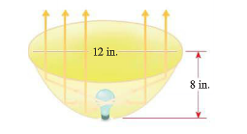
Application Example:
A searchlight has a parabolic reflector that forms a “bowl” which is 12 inches wide from rim to rim and 8 inches deep. If the filament of the light bulb is located at the focus, how far from the vertex of the reflector is it?

Slide 14
Homework #2: Parabolas - 2nd Semester
Section 11.1: Page 730-732 #11, 13, 15, 20, 29, 33, 53, 56

