Slide 1
Honors Precalculus Do Now:
Intro to Statistics
An individual (in the US) gets tested for HIV and tests positive. The test is 99% accurate. In other words, there is a false positive rate of 1%. Given that 1 in 300 people in the US population has HIV,
What is the probability that the individual who tested positive, actually has HIV?
TRY IT OUT!

Slide 2
Video on Statistics
TedTalk
Peter Donnelly
http://www.ted.com/talks/peter_donnelly_shows_how_stats_fool_juries.html

Slide 3
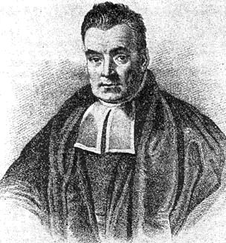
Bayesian Statistics
THOMAS BAYES: 1701-1761
BAYES THEOREM:
CONDITIONAL PROBABILITY:
BASE RATES!

Slide 4
Example 1: STD’s
A MAN TESTS POSITIVE FOR A SEXUALLY TRANSMITTED DISEASE. THE TEST IS 98% ACCURATE. IF THE PREVALENCE OF THE DISEASE IN SOCIETY IS 1 IN EVERY 1,000, WHAT IS THE PROBABILITY THAT THE PERSON ACTUALLY HAS THE DISEASE?

Slide 5
Example 2: GINGIVITIS
Gingivitis is the most common disease in the US. About 60% of people have gingivitis. The test for gingivitis is also quite accurate. The test for gingivitis is 95% accurate. Given that a person tests positive for gingivitis, what is the probability that they actually have the disease.

Slide 6
EXAMPLE 3: BAGS SCREENED
BAGS are screened at the PROVIDENCE airport. 78% of bags that contain a weapon will trigger an alarm. 14% of bags that do not contain a weapon will also trigger the alarm. If 1 out of every 1200 bags contains a weapon than what is the probability that a bag that triggers an alarm actually contains a weapon?

Slide 7
HOMEWORK ON BAYES!
Complete the following homework on Bayesian Probability.

