Slide 1
HPC: Warm-Up
QUIETLY look over your Trig Quiz 6.1-6.3. Don’t discuss your grade with others!!
Agenda:
Unit Test on Ch. 6 on Friday, March 7th
Conic Sections Projects are due Tuesday, March 11th.
How to submit.
Go to dropitto.me/byoung15
Password: mosesbrown
Uploads files up to 75mb.
If you have a file bigger than that (like a movie). Bring a thumb drive with the video or post it to youtube (privately) and send me the link.
If you used prezi or some other media source that has a link, email me the link.

Slide 2
Idea of the Day
http://www.nydailynews.com/news/world/stuntman-runs-amazing-vertical-loop-article-1.1698615

Slide 3
Section 6.4: We will come back to graphing inverse trig functions when we do chapter 5 (we will only do Example 3-6 from 6.4)

Slide 4
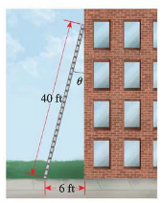
You Try

Slide 5
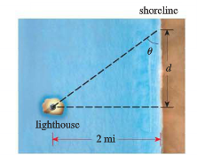

Slide 7
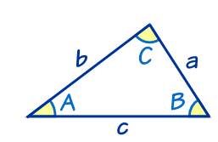
The Law of Sines (6.5): PROOF

Slide 8
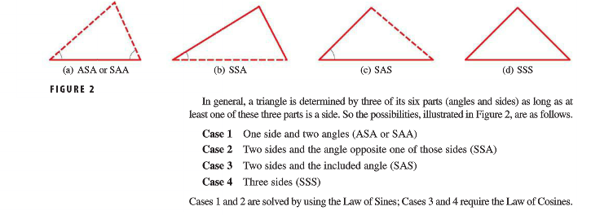
Some Quick Reminders

Slide 9
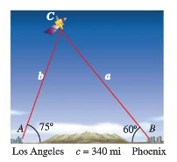

Slide 10
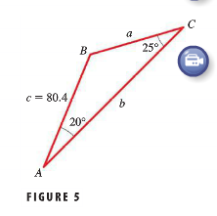

Slide 11
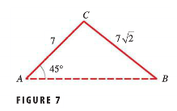
SSA: The Ambiguous Case

Slide 13
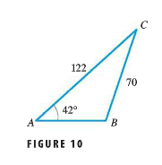

Slide 14
HW #13 Inverse Trig Functions and Law of Sines
Section 6.4 #15, 37, 39
Section 6.5 #3, 5, 19, 21, 31, 33, 39

